Slide 1
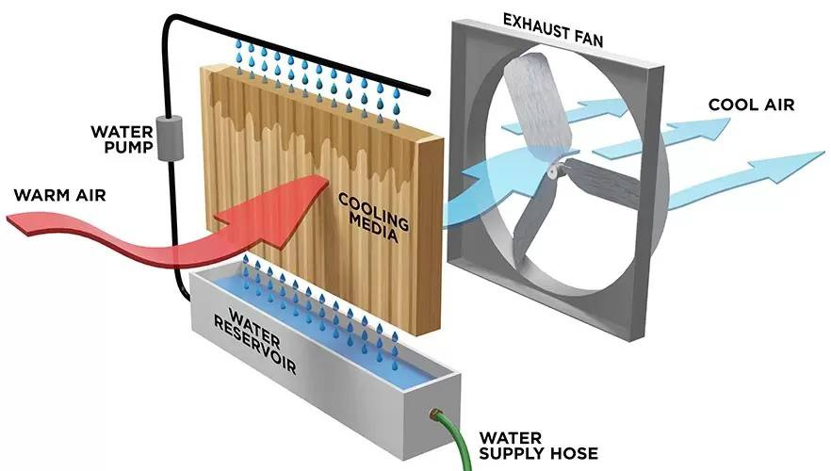
Vanadium Flow Modular Energy Storage System
TEAM
048
INSERT HERE The Multi-Disciplinary Strength logo
Moath Althuwadi, AbdulAziz Alharbi, Ryan Alghamdi, Mahmoud Binladen
Coach: Ali Al-Khazraji
Background
Prototype Design
Testing
Conclusion
Large-scale solar farms in Saudi Arabia face significant challenges in storing energy efficiently due to high ambient temperatures and fluctuating generation from intermittent renewable sources. Conventional lithium-ion batteries degrade rapidly in this heat and have a limited lifespan. To support the Kingdom's renewable energy goals, a robust, heat-tolerant storage solution is required.
The prototype utilizes a modular tank-stack architecture allowing for independent scaling of power and energy.
Chemistry:
Aqueous Vanadyl Sulfate (VOSO4​) in Sulfuric Acid (H2​SO4​) with histidine stabilizer.
Thermal Management:
An evaporative cooling system was implemented to manage the thermal load. This system utilizes the high latent heat of vaporization of water to absorb waste heat. It is specifically designed for the hot, dry Saudi climate, offering superior cooling performance compared to standard air convection.
Control:
Integrated sensors (flow, level, temp) with a Battery Management System (BMS) for real-time State of Charge (SoC) monitoring.
Capacity Validation:
Using C=1.6 mol/L and a utilization factor of 0.8, the theoretical capacity was calculated as 34.3 Ah.
Thermal Validation:
Cooling Strategy: The evaporative cooling system was validated to dissipate this 12 W load by leveraging phase-change heat transfer. This method maintains the electrolyte temperature within the stable range (15–40 °C) more effectively than passive radiation, particularly during peak daytime temperatures.
Proof that Specifications were Met
Energy Requirement: The calculated capacity of 34.3 Ah confirms the system meets the energy density targets for the 2 L form factor.
Thermal Safety: The evaporative cooling ensures that the 12 W of generated heat is actively dissipated. This prevents the stack temperature gradient from exceeding 5∘C and keeps the bulk electrolyte below the critical 40 °C threshold, even in harsh ambient conditions.
designed a Vanadium Flow Modular Energy Storage System optimized for the Saudi Arabian environment. By integrating an evaporative cooling solution, the design capitalizes on the region's dry climate to solve the critical issue of battery overheating. The system is scalable, cost-effective, and validated to operate safely without the rapid degradation seen in conventional lithium-ion batteries.
Problem Statement
Current battery technologies lack the thermal stability and longevity required for grid-side operation in Saudi Arabia's desert climate. There is a critical need for a storage system that can operate safely in high temperatures without complex active cooling systems, while remaining cost-effective and recyclable

