Slide 1
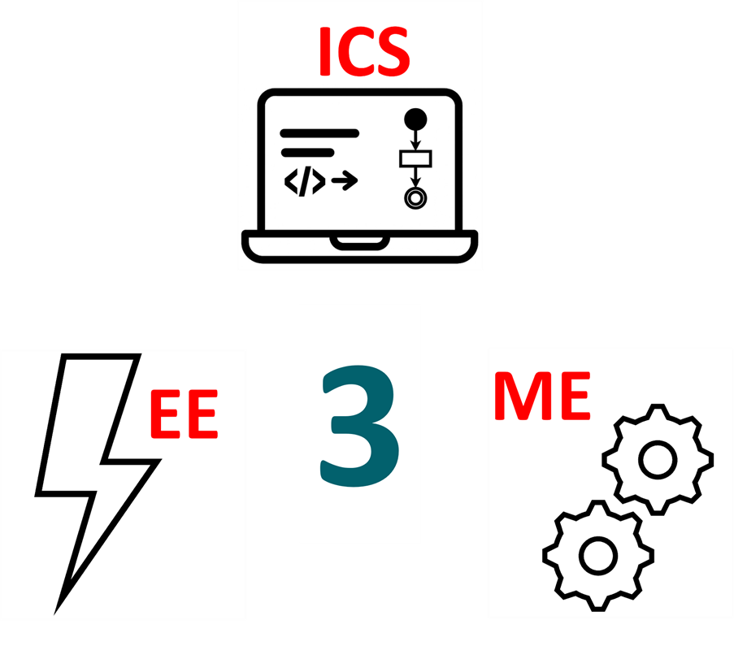
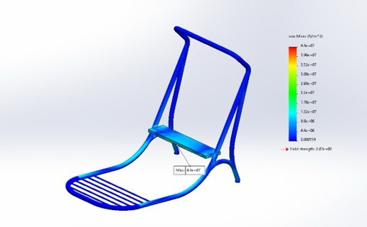
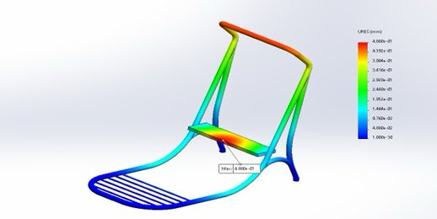
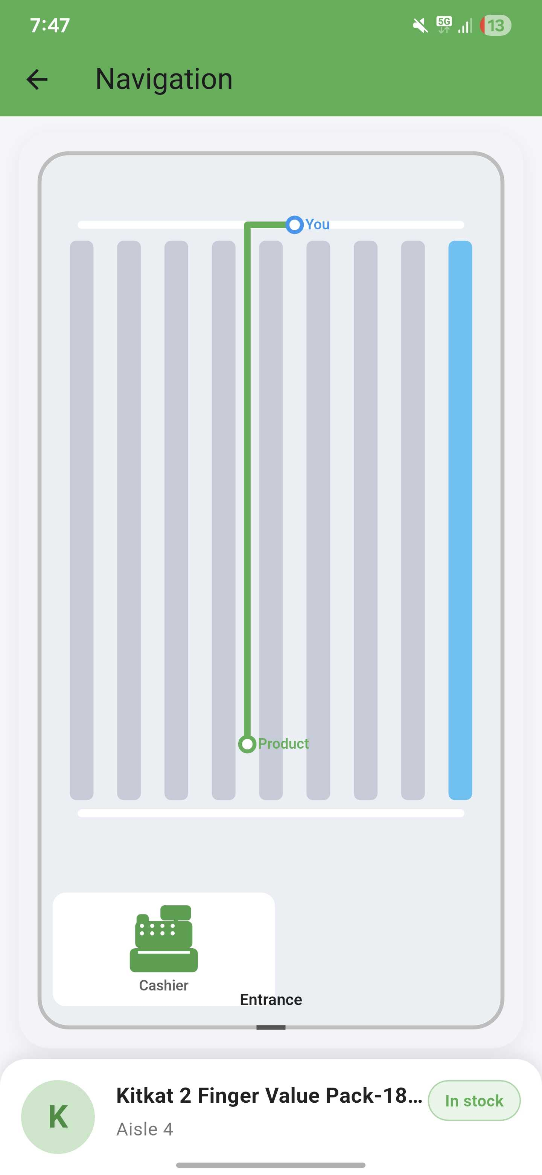
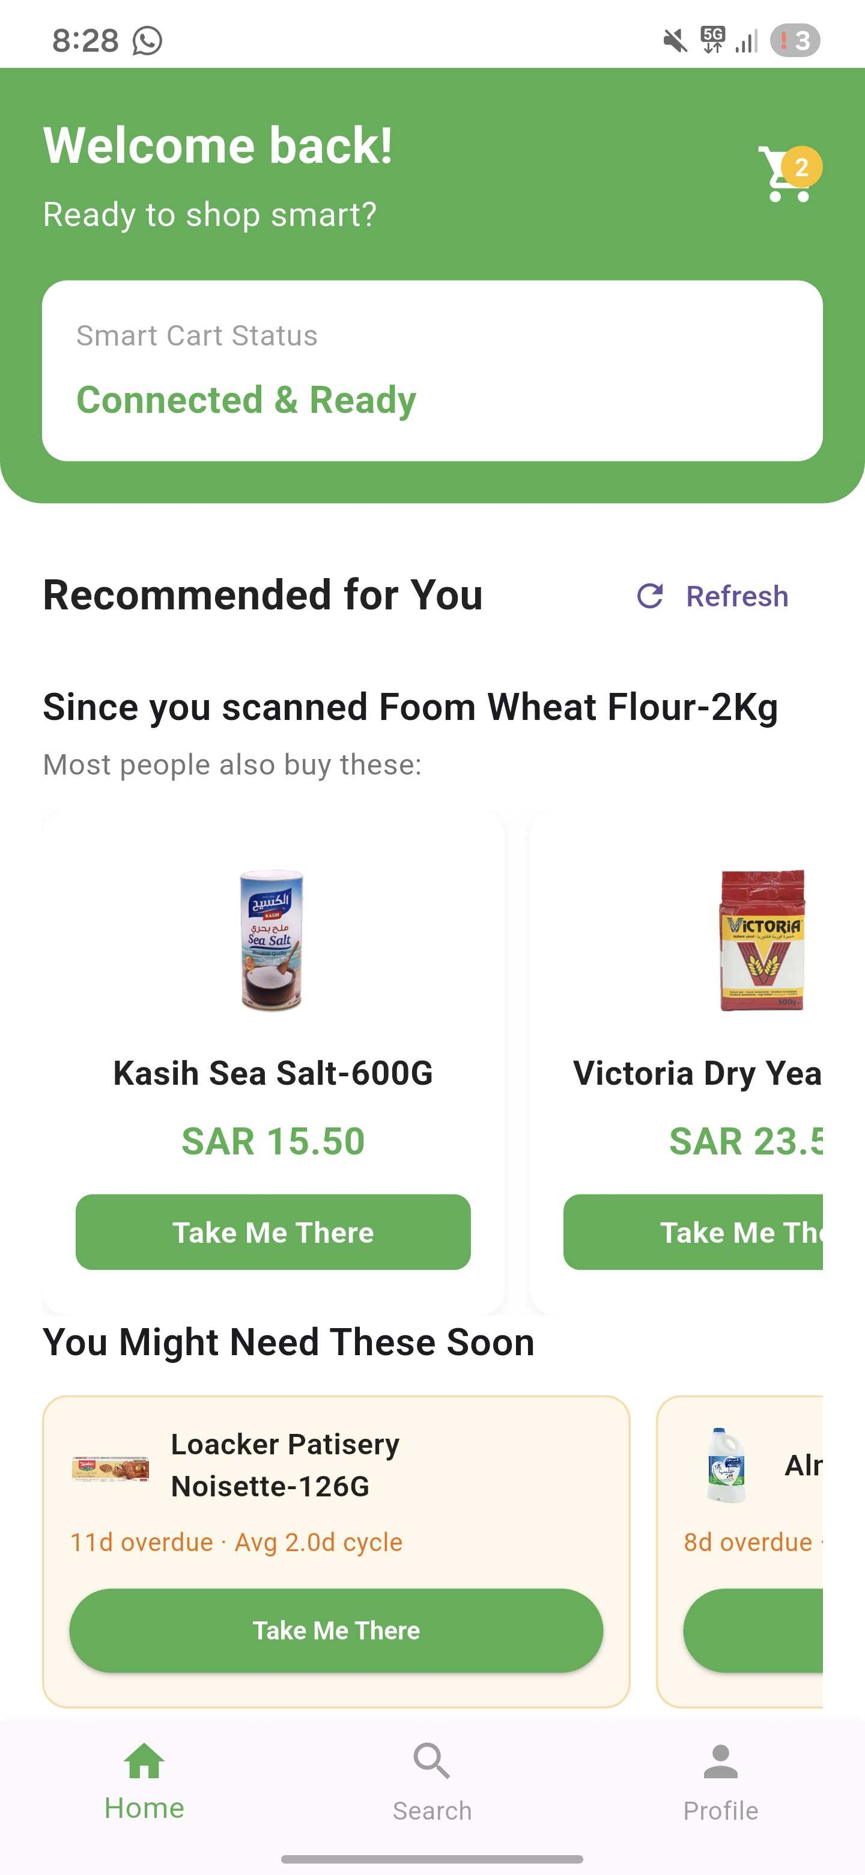
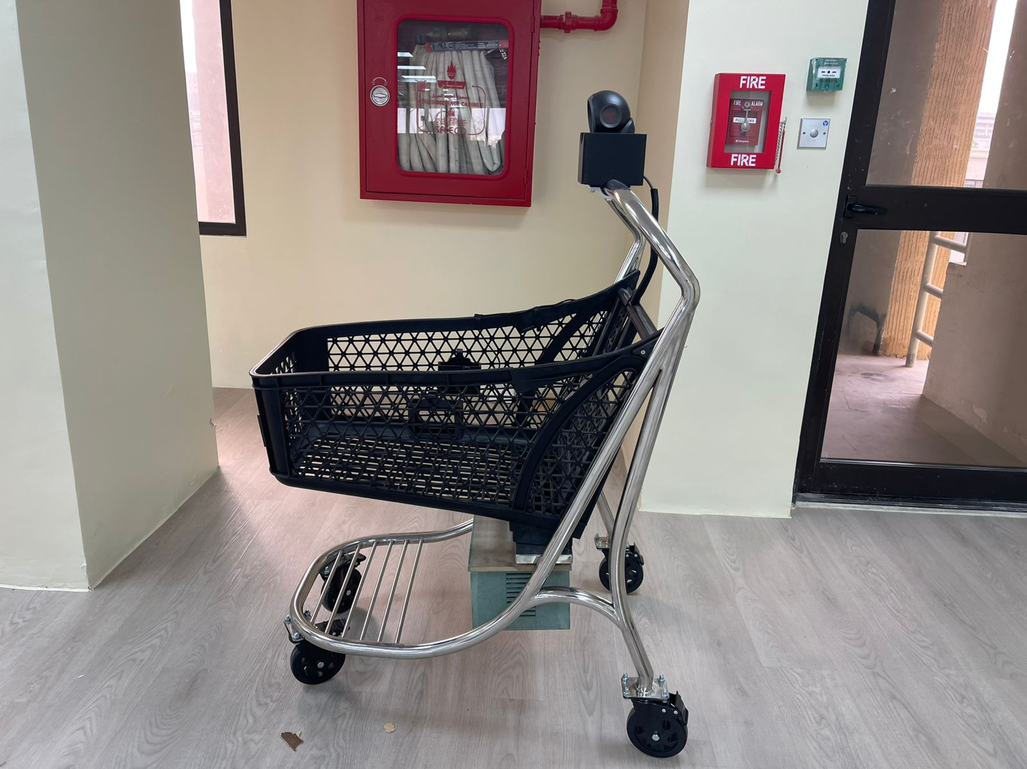
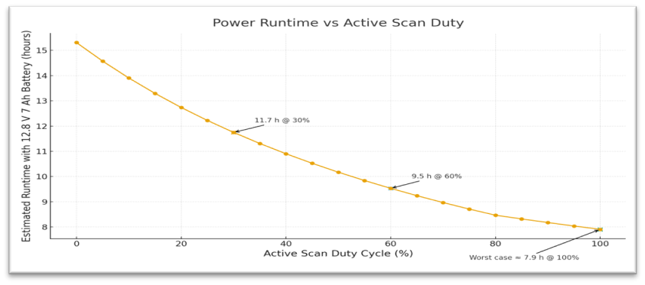
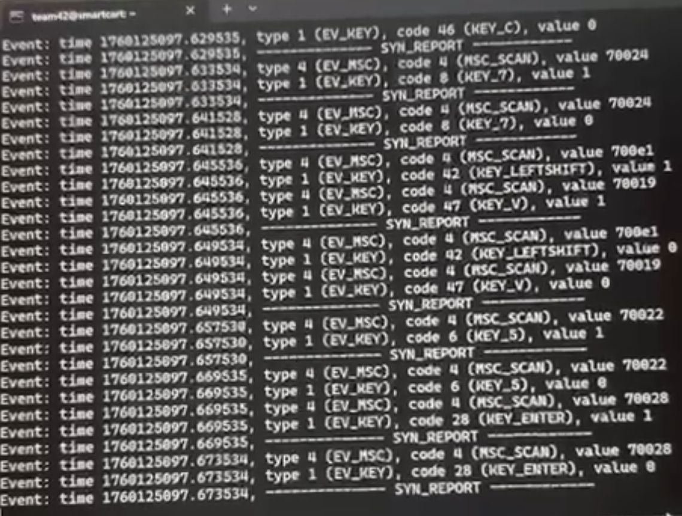
Smart Shopping Cart with AI-Driven Shopping Assistance & Aisle Navigation Application
TEAM
042
Hassan AlJafar (EE), Osama Alghannam (ICS), Abdulrahman Alhamli (ICS), Mashal Alruzagqi (ME)
Coach: Fadi Al-badour
Problem Statement
Testing / Validation
Specifications
Supermarkets still struggle with customers spending too much time searching for products and waiting in checkout lines. Current smart-cart solutions are costly and tied to specific retailers. Our project introduces a scalable Smart Shopping Cart with real-time scanning, AI recommendations, and aisle navigation to improve the in-store experience.
Cart structure
Online billing within 2s
Barcode scanner reads < 2s
RFID scanner reads < 2s
AI recommendation system
Checkout within 3 clicks
Cloud integration < 1s
Barcode and RFID scanner accuracy >99%
Total cart weight < 25kg
Breaking mechanism integration (remains stationary on <= 10°)
Withstands 40kg static load (no permanent deformation)
Battery life > 4 hours
Aisle navigation accuracy > 99%
Max Stress: 44 Mpa
Maximum deformation: 0.488 mm
Objective
Aisle navigation
AI recommendation
To design and implement a smart shopping cart system that integrates real-time barcode/RFID scanning, accurate aisle navigation, and an AI-driven recommendation engine through a mobile application to enhance the shopping experience.
Constraint
Rechargeable battery
Hardware compatibility
Real-time processing < 1s
Load capacity: 60kg
Ergonomic & lightweight Design (high maneuverability
Final Prototype
Power Analysis
Barcode RFID Test

