Slide 1
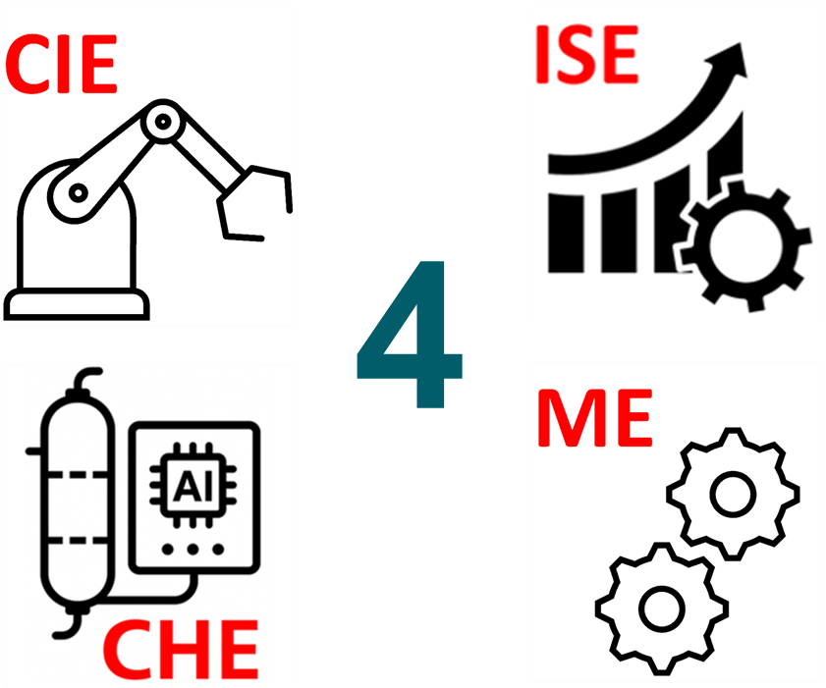
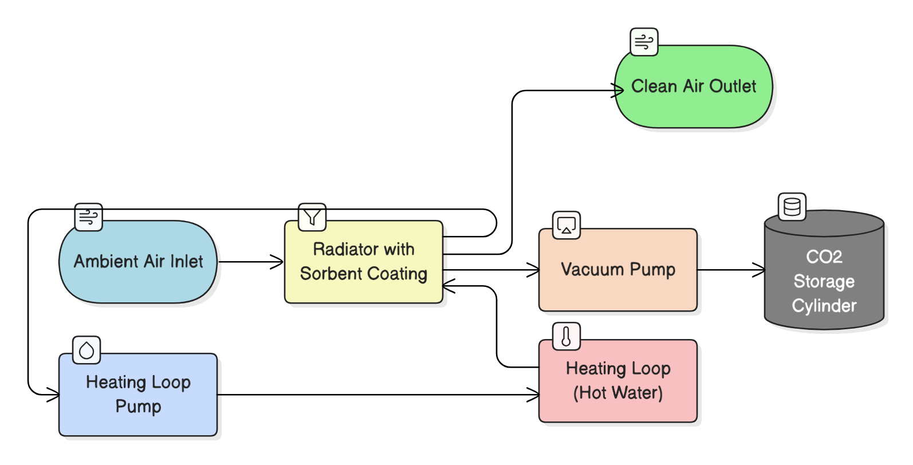
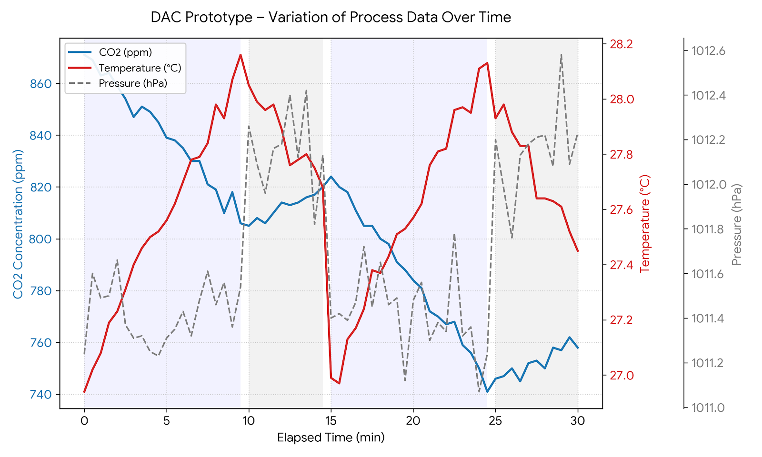


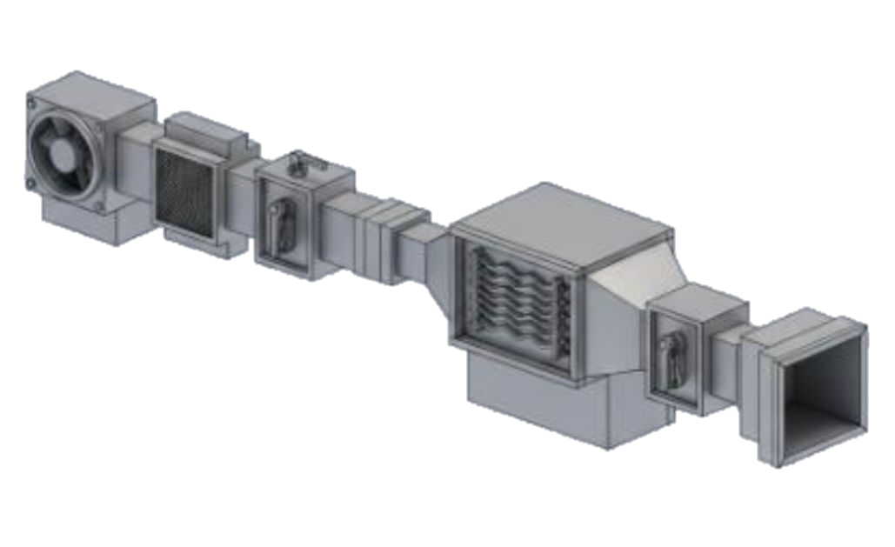


Mitigating Climate Impact through Effective CO2 Adsorption with Solid Sorbents by Direct Air Capture
TEAM
041
Khalid Alghamdi, Abdullah Alomari , Talal Alshehri- ISE, Azzam Al-Muwallad-CIE Coach: Firas Al-Hindawi
Background
Constrains
Block Diagram
Testing / Validation.
CO₂ levels in the atmosphere continue to rise, intensifying climate change and environmental challenges. Direct Air Capture (DAC) technology enables the removal of CO₂ directly from ambient air to achieve negative emissions. This project develops a compact DAC prototype using solid sorbents and controlled regeneration to support scalable carbon-removal solutions.
Constraint | Evidence
Compliance with Saudi standards | SASO-approved electrical and safety components used.
Renewable energy integration | Solar panels supply ≥30% of total power.
Sustainable materials | Galvanized steel frame; ≥20% recyclable parts.
Continuous operation | Completed one full adsorption–desorption cycle.
Prototype footprint | Compact setup within ≤2 m² lab area.
Problem Statement
Specification
Prototype
CONCLUSIONS
Current DAC systems are energy-intensive, costly, and hard to operate. This project develops a compact, renewable-powered DAC prototype with efficient CO₂ capture and sustainable materials.
The project delivers a compact DAC prototype integrating automated sensing, renewable-ready control, and multi-variable analysis. It shows reliable CO₂ capture, consistent sorbent cycling, and strong data validation. With improved housing, heating, and modular sorbent cartridges, it can become a low-cost, scalable DAC for homes, schools, and remote sites.
An operator should
reach basic proficiency
within 3 hours of training.
CO₂ capture efficiency
between cycles
should vary by
under 10%.
Main components should last
at least 6 months under normal
conditions to ensure reliability
and reduce downtime.
Peak power consumption
should not exceed 4 kW at any
given time during operation.

