Slide 1
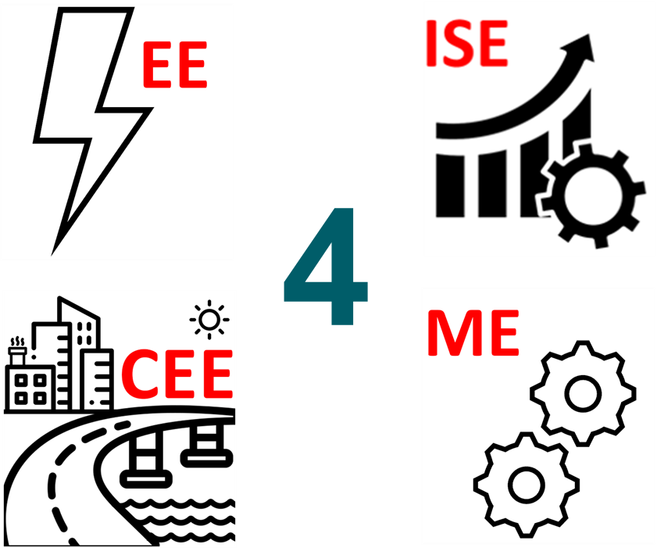
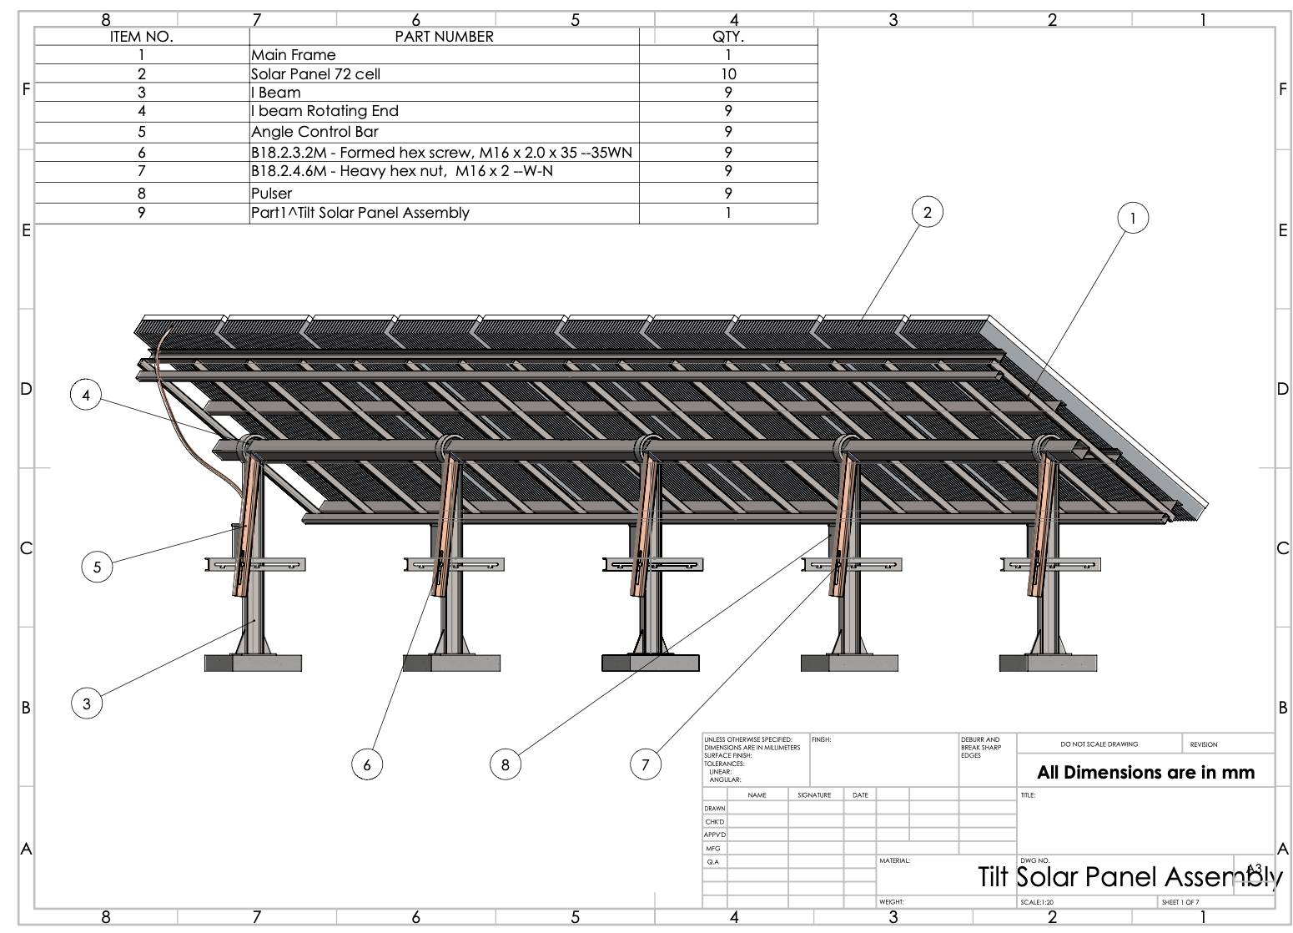
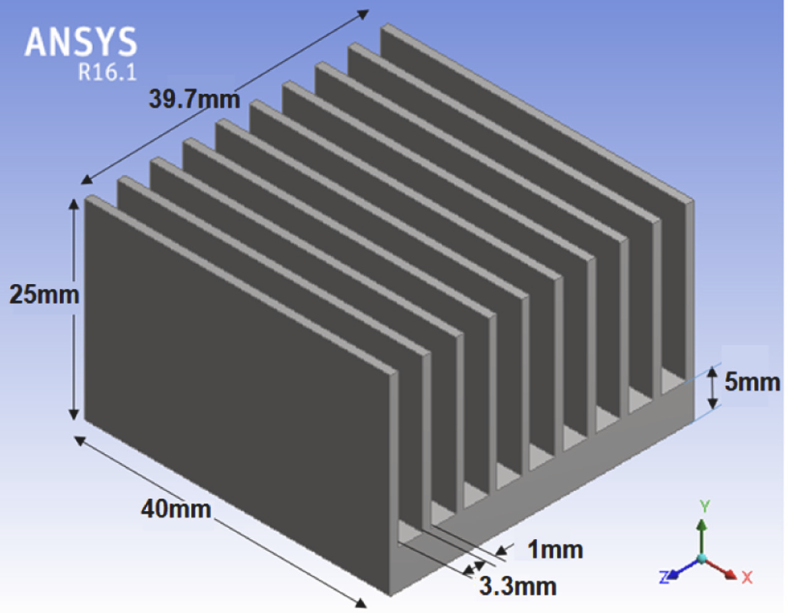
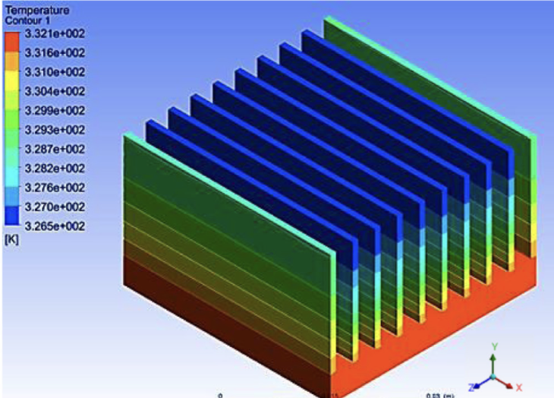
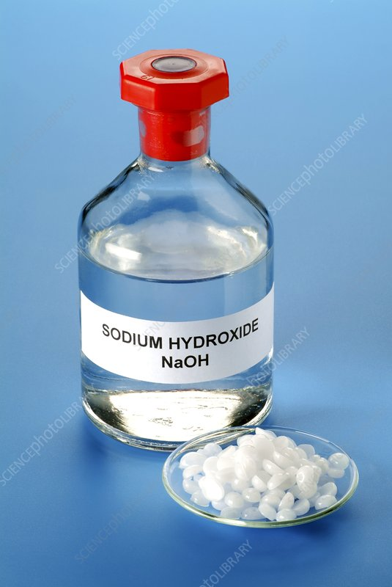
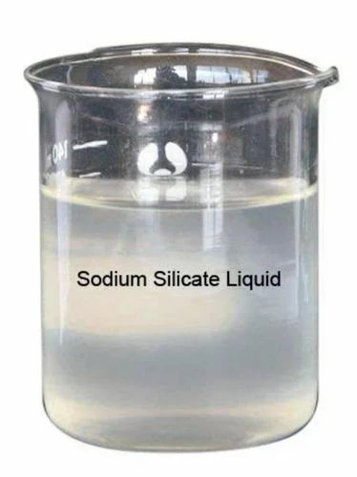
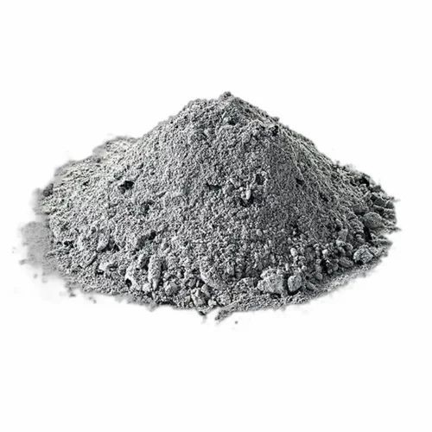
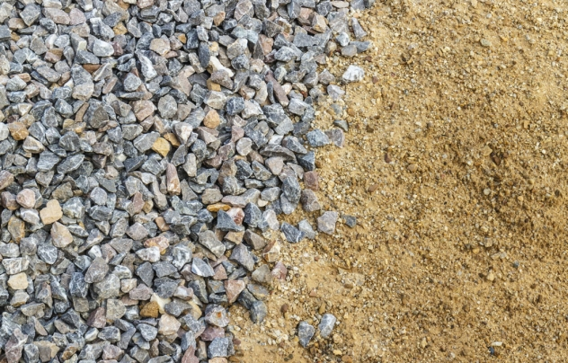
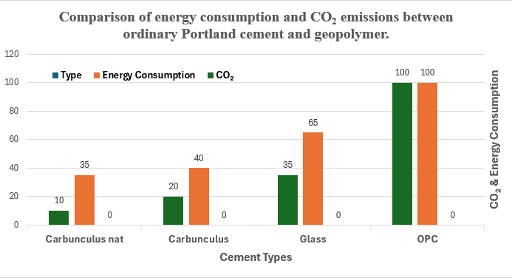
Self Cleaning Solar Panel for EV Charging Station Using
Eco-Friendly Construction Materials
TEAM
32
Nawaf Alnemari, Feras Alsaedi, Abdulaziz, Mohammed Alshehri
Coach: Dr. Asaad Hanif
Problem Statement
Prototype Design
Specifications
Dust accumulation and extreme heat can reduce solar panel efficiency by over 30%, making off-grid EV charging systems unreliable and costly in desert environments. As demand for clean transportation increases, existing charging solutions become economically and environmentally unsustainable, especially where grid power is limited. This project proposes a geopolymer concrete base to deliver a durable, efficient, and low-maintenance EV charging solution.
CAD Design
Self-Cleaning Coating: Dual-layer AZO/TiO₂ applied on PV glass.
Cooling: Fins reduce PV backsheet temp by ≥7 °C at noon (target 5–10 °C).
The battery storage should ensure one full charge without solar input.
Material cost per station must be ≤ 9850 SAR
Voltage Output Stability, Charger voltage must remain within ±5% variation (SPC-monitored)
Designed to function within a temperature range of -10°C to 55°C using heat-resistant materials
The concrete shall have a compressive strength of 30 MPa ± 2 MPa
The project should fully recharge the test object in less than 5 hours
The system at least should provide 100wh of usable energy
Base Row Materials
Heat Transfer Simulation
NaOH (+ H₂O) Na₂SiO₃ FlyAsh ( F )
Sand & Aggreg.
Testing / Validation
Conclusion
Constrains
220VAC at 60Hz.
Ability to withstand in higher-than-average wind speeds in Saudi Arabia (≥ 15 km/h).
Material cost must be affordable and not exceed 9850 SAR.
Application of Geopolymer Concrete.
The project improved solar performance by restoring up to 94% of the panel’s effective efficiency through integrated dust-repellent coatings and passive cooling fins. It lowered operating temperatures, reduced dust losses, and demonstrated a reliable, durable, and environmentally friendly charging solution.

