Slide 1
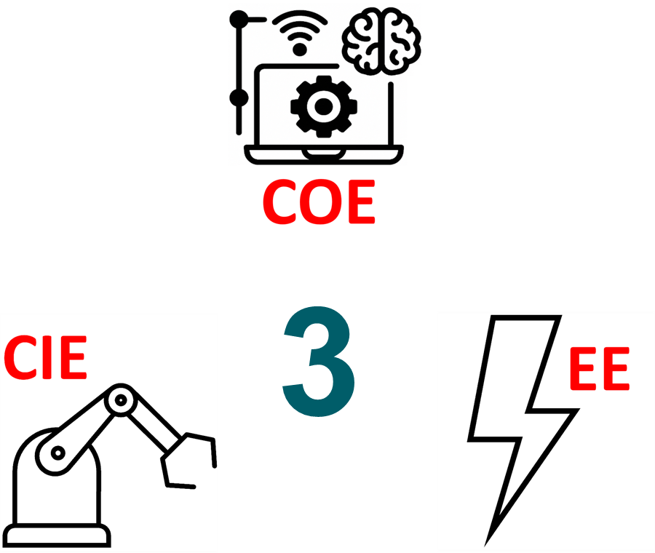
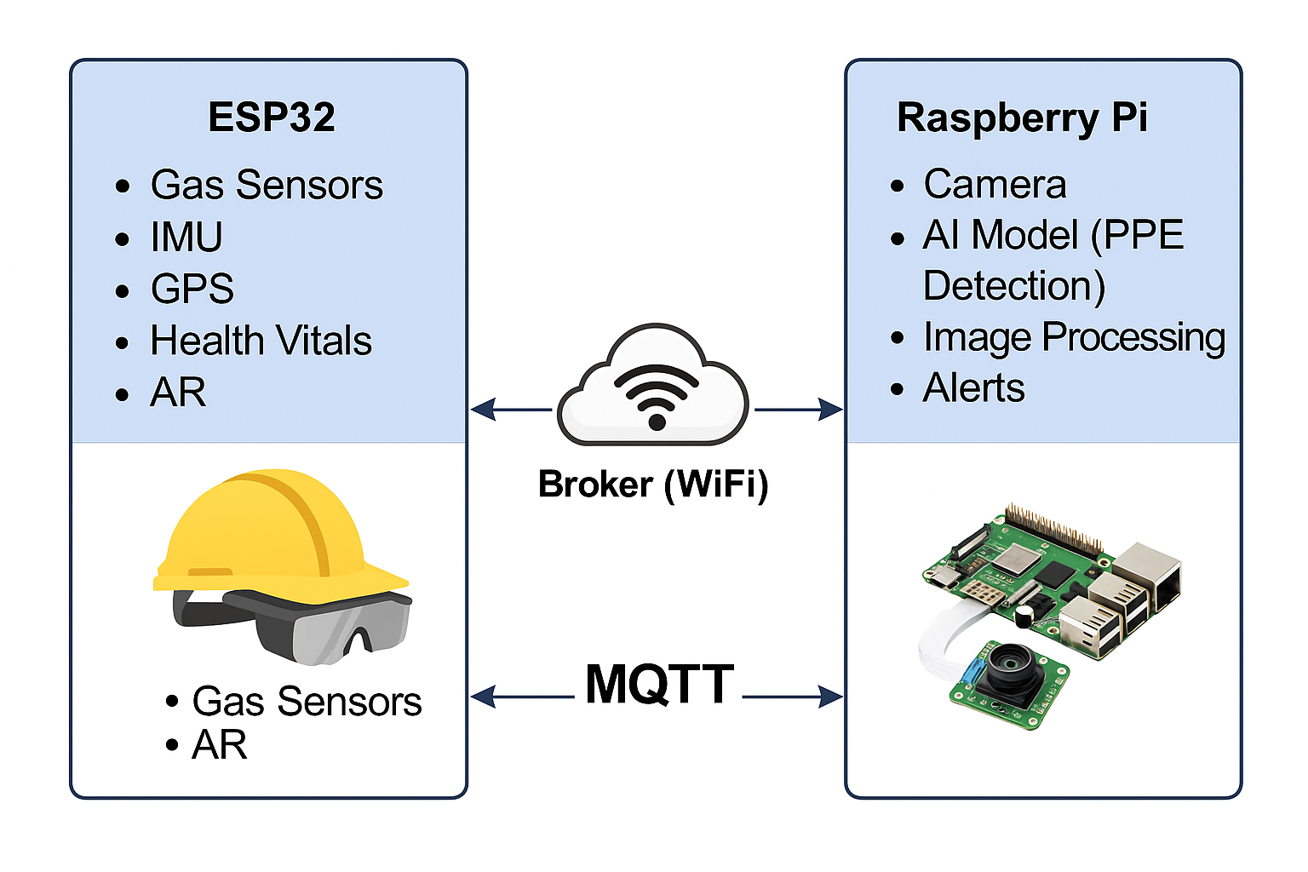
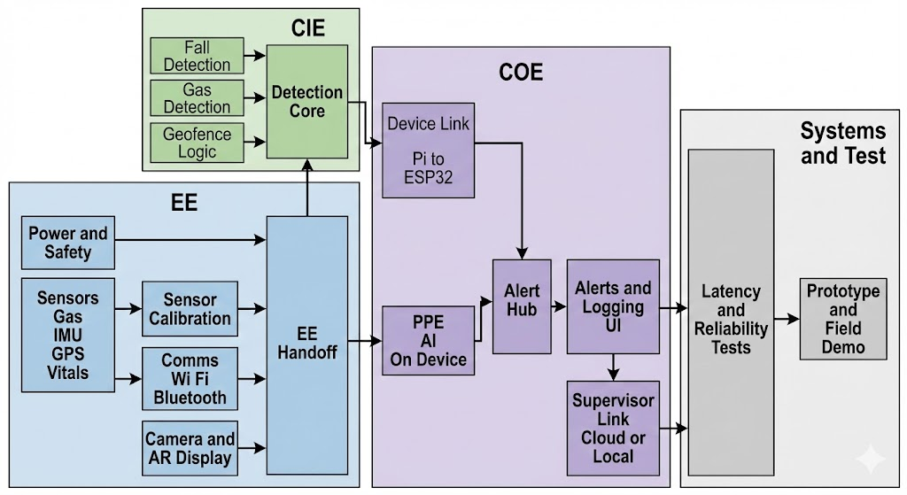
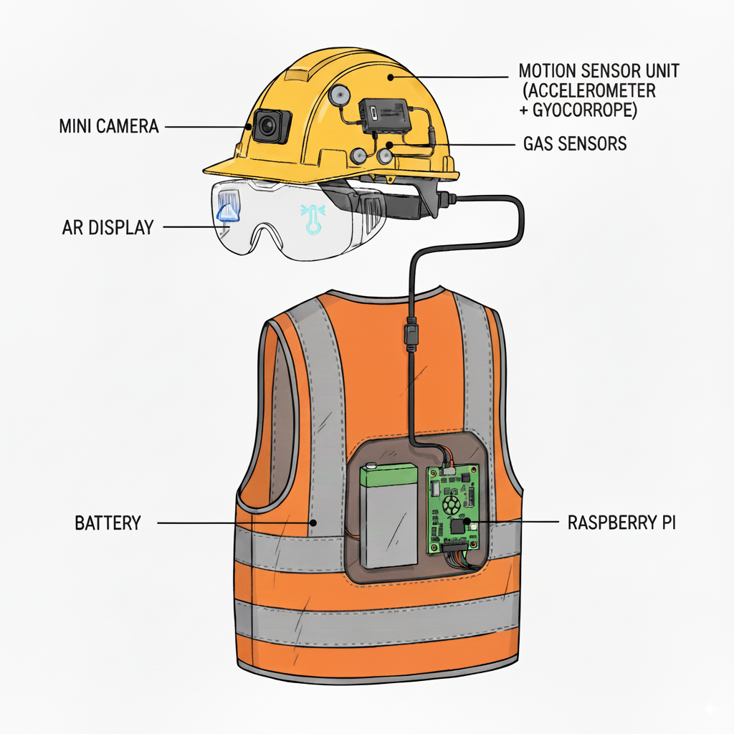
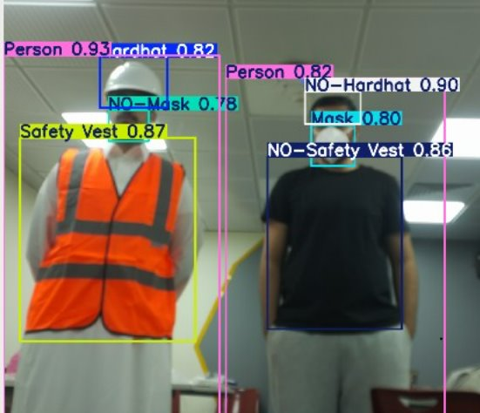
Smart Construction Safety Helmet
with Smart Safety Goggles
TEAM
29
Abdulmajeed Alnemer, Faiez Alsawit, Ahmad Aldkhil, Albaraa Alrehaili
Coach: Dr. Muhammad Emzir
Objective
Constrains
System Design
System Architecture
Develop a Smart Construction Safety Helmet with AR Goggles to enhance worker safety
Provide real-time monitoring of PPE compliance, toxic gases, falls, vital signs, and geofencing
Replace manual safety supervision with automated, continuous, digital monitoring to reduce accidents and improve emergency response.
Integrate AI, IoT, and AR technologies into a single unified system to proactively detect hazards before they escalate.
Sensors operate from –20°C to +50°C
Gas/hazard alerts in ≤5 s
Stable DC power (±5%) required
AI model must be TFLite on Raspberry Pi
AR display brightness 100–150 cd/m²
Raspberry Pi stays <75°C
Low-voltage wiring (≤5V) fully insulated
AR display must keep 85° field of view.
Specifications
Prototype Development
AI model accuracy ≥70%.
CPU must operate below 85% load to avoid overheating.
Gas sensor sensitivity <200 ppm.
Gas system must respond in <10 seconds.
Sensor readings must be available within 4 seconds.
Fall detection must respond within 7 seconds.
IMU detects falls from >3 meters.
Temperature alarms if >45°C or <–10 C.
GPS accuracy ≤10 m in open areas.
PPE AI must process each frame in ≤5 seconds.
System reconnects to Wi-Fi within 1 minute.
Gas sensors must detect concentration changes in ≤5 seconds.
Background & Problem Statement
Results & Conclusion
Construction sites expose workers to toxic gases, extreme heat, falls, and PPE violations
Safety officers cannot reliably monitor large sites or detect hazards in real time
Manual supervision leads to delayed emergency responses, increasing injury and fatality risks
Workers often ignore PPE requirements due to discomfort, causing preventable accidents.
Gas, IMU, GPS, and AR performed reliably: gas 3–5s, fall >90%, GPS ±3–5m, AR <3s.
AI PPE model achieved stable performance with ~70%+ accuracy on real-site images..
Validation & Verification
Constraints fully validated, including temperature limits, field-of-view, DC power stability, wiring, and thermal performance.
Specifications met, including gas detection 3–5s, fall detection <7s, GPS ≤10m, PPE AI ≤5s, Wi-Fi reconnect ≤1min, and MQTT alert latency <1s with stable real-time operation.

