Slide 1
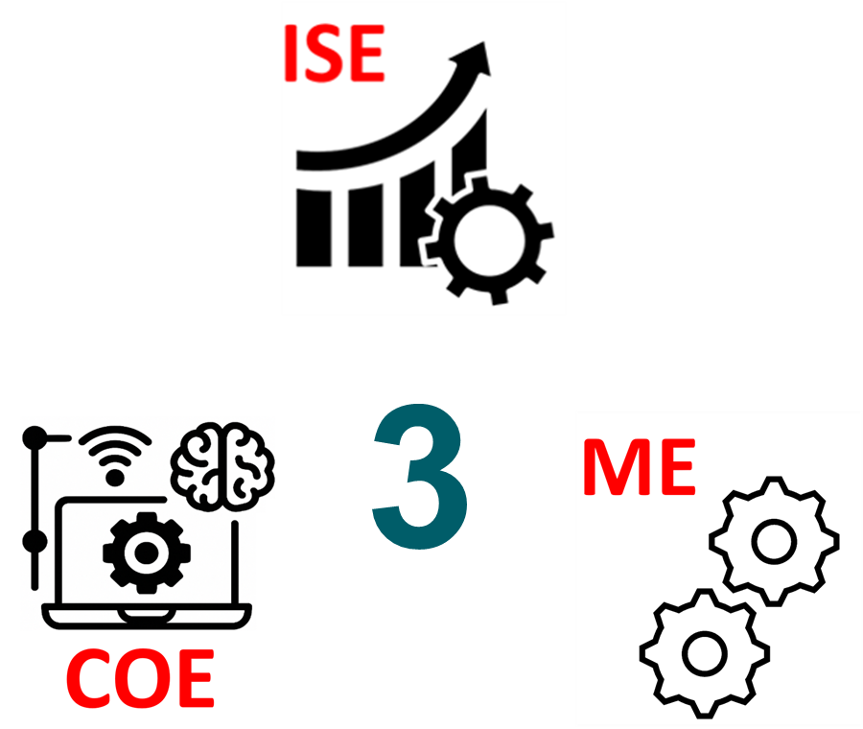
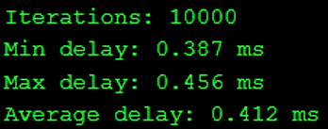
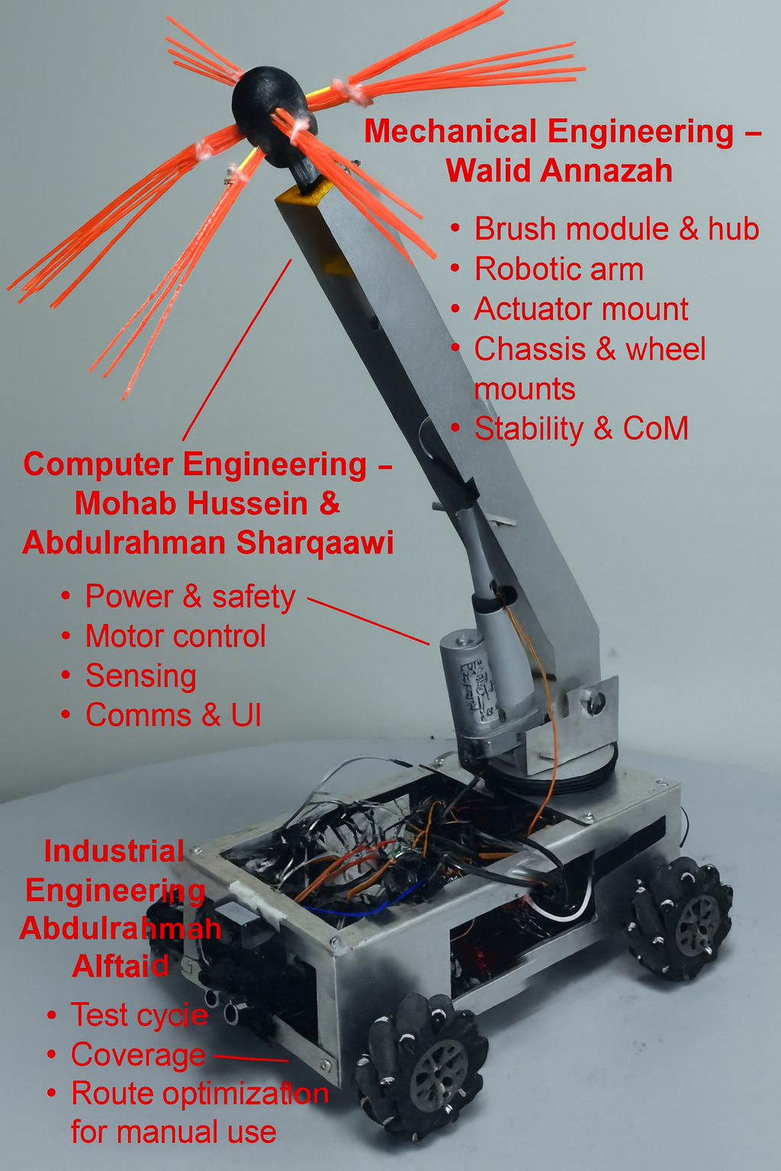
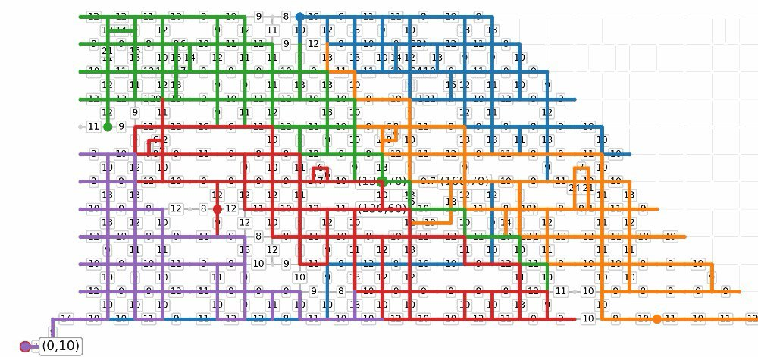
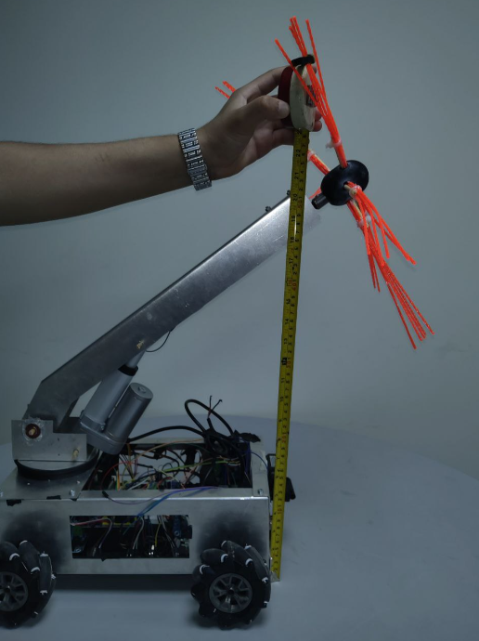
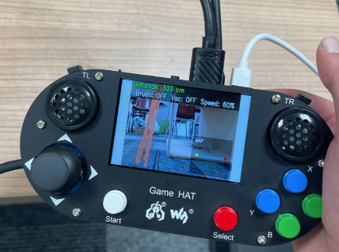
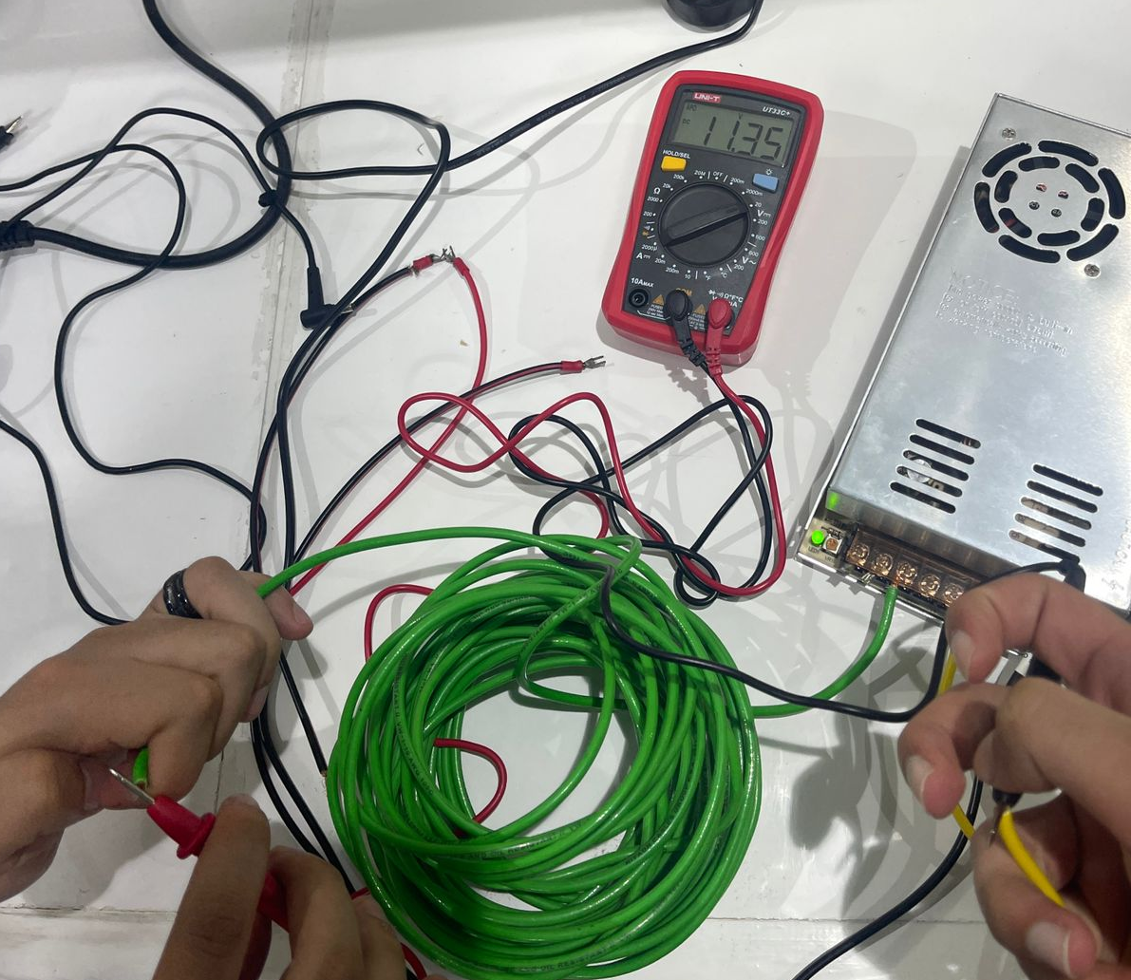
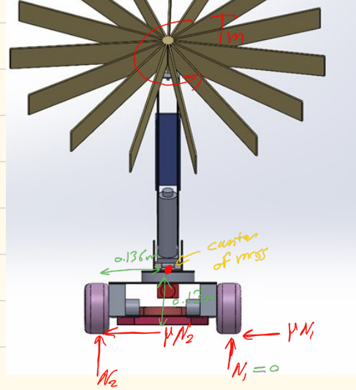
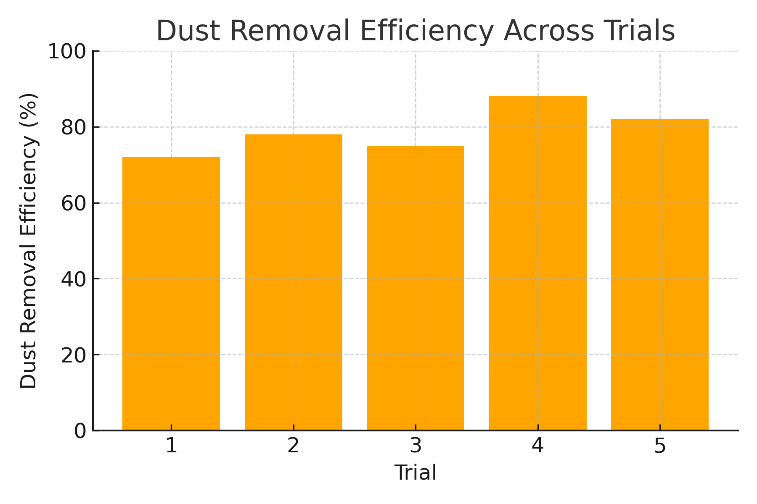
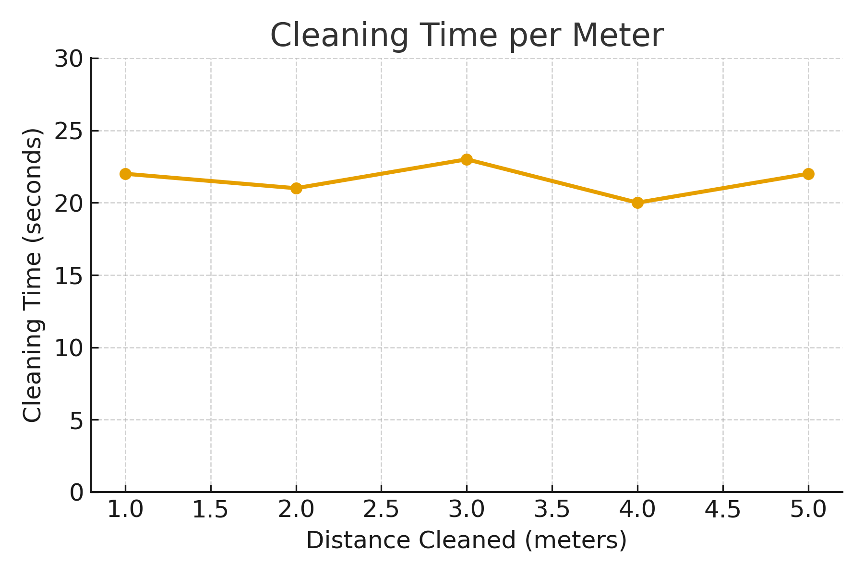
Dust Cleaning Robot in Industrial
HVAC Systems
TEAM
26
Abdulrahman Sharqawi (COE), Walid Annazhah (ME), Mohab Hussein (COE), Abdulrahman Alfhaid (ISE)
Coach: Dr. Fadi Al-Badour
PROBLEM STATEMENT
Robot System Design & Methodology
SPECIFICATIONS
Air quality in many facilities declines due to dust buildup inside HVAC ducts, yet current cleaning methods are slow, costly, and unable to reach complex duct geometries. This project develops a low-cost, remotely operated cleaning robot offering an effective solution for thorough dust removal and improved system performance.
Low latency:
Multi Robot
Optimal Path:
Control delay <= 1second
Collision within 5 cm
Reaches everywhere:
30 Degree Slope
Brush up to 65 cm
Path Optimized
Remove 60% of the Dust
It has two axis motion.
Travels 10 meters every cycle
Constraints
Power Converter:
Controlled by Operator:
Robot Size must not exceed 50 × 40 × 30 cm.
Robot operates in ducts up to 65cm height
Robot weight should be less than 20kgs.
CONCLUSION & FUTURE WORKS
The HVAC duct-cleaning robot met all key specifications, demonstrating effective mobility, brush reach, dust removal, and responsive control. Future improvements include adding autonomous navigation, improving dust collection, and integrating sensor mapping with wireless control for better usability.
Testing & Validation
Tipping Over Calculation:
Dust Removal Efficiency:
Cleaning Time per Meter:
HVAC dampers must be fully opened.
Ethernet tether length is limited to 100 meters.
The robot will not operate in vertical duct sections.

