Slide 1
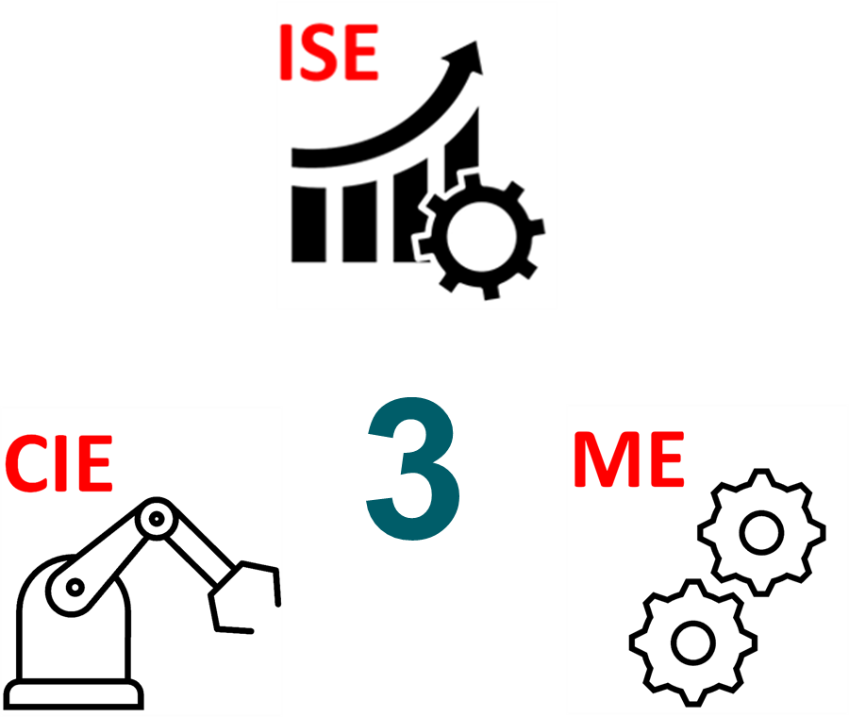
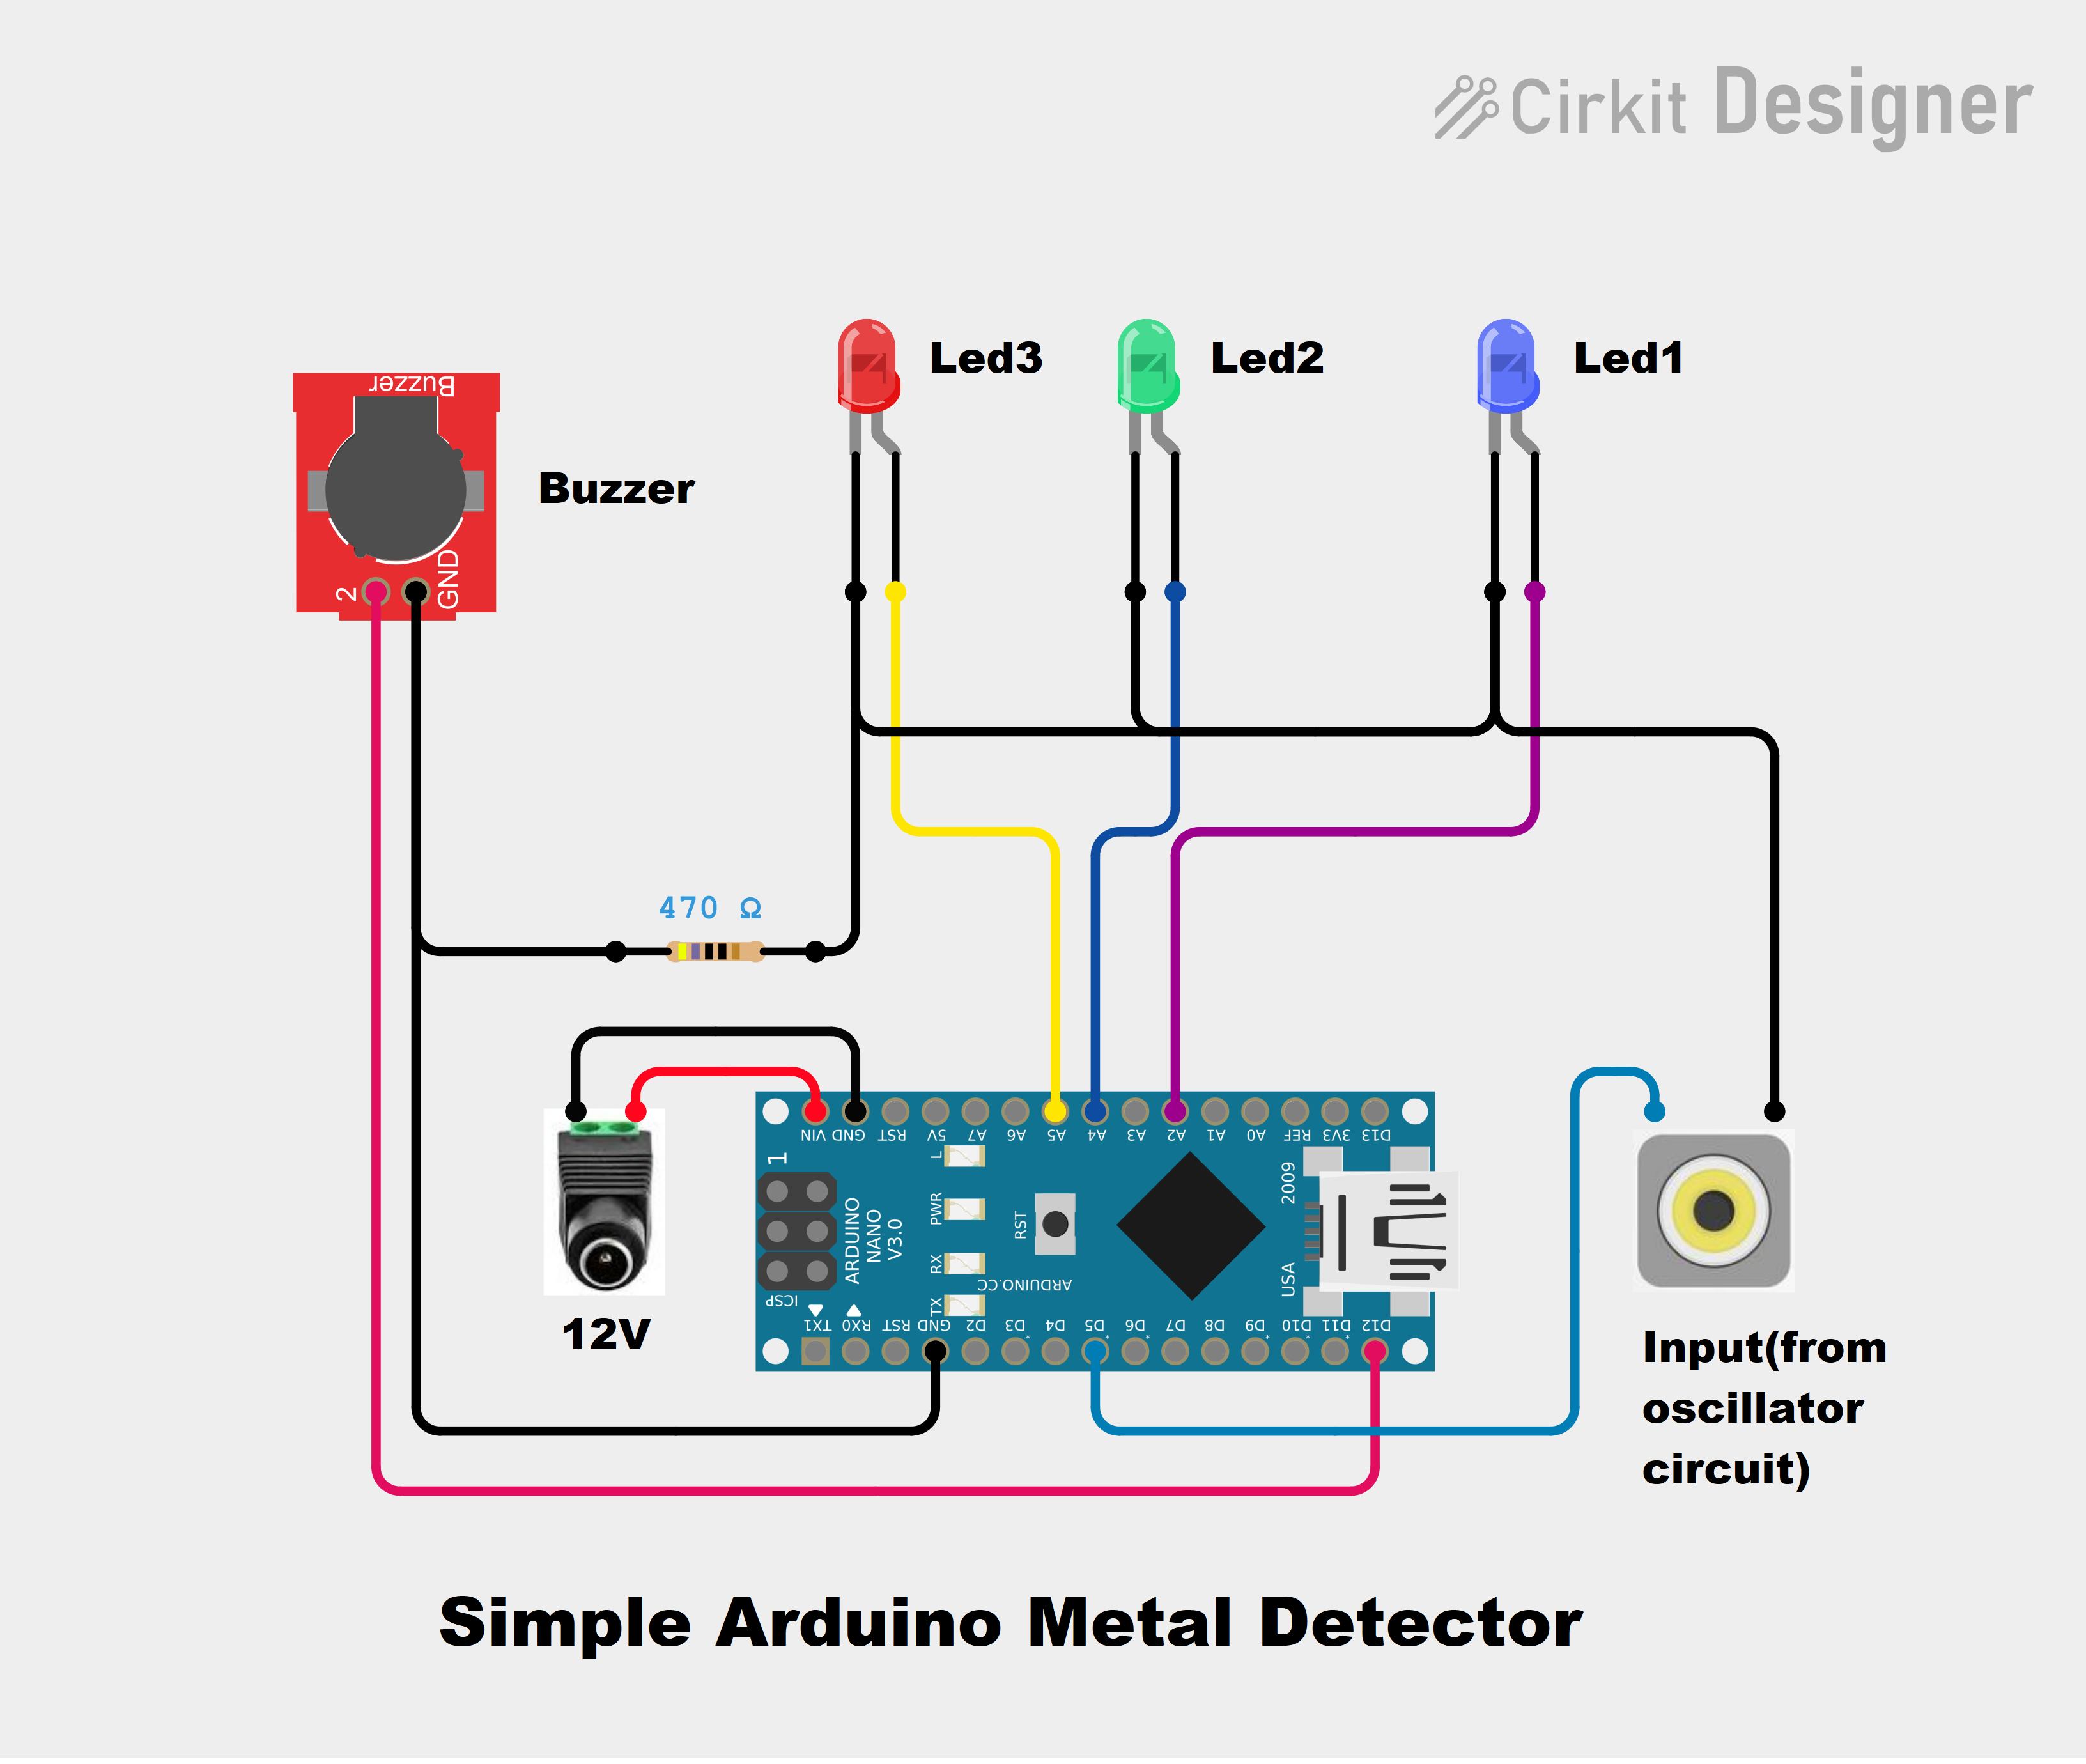
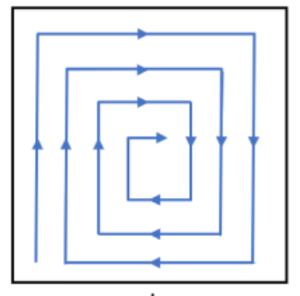
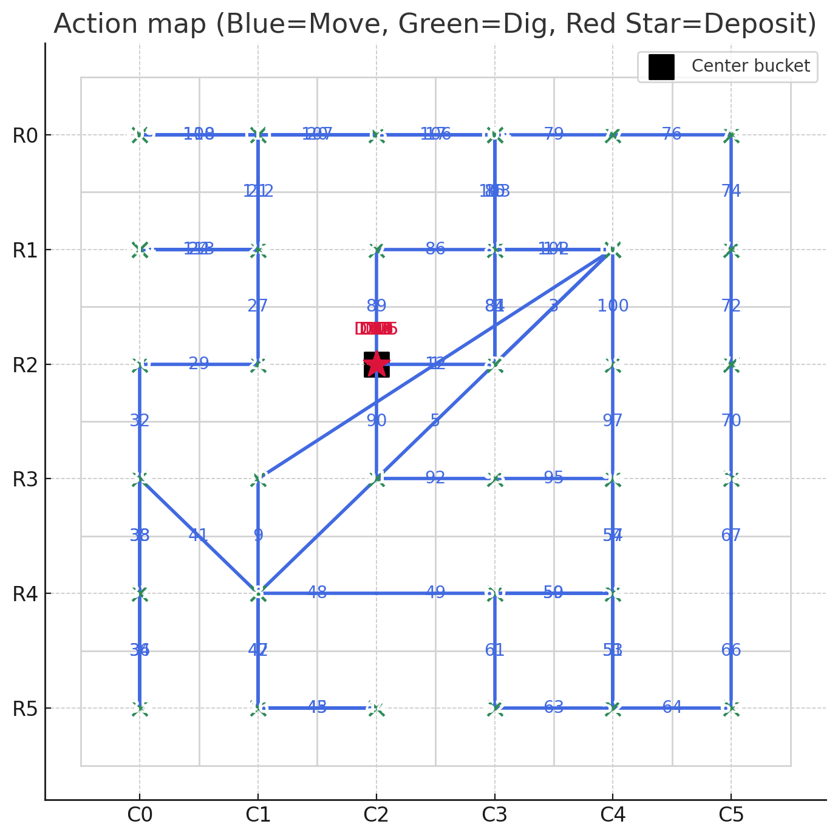
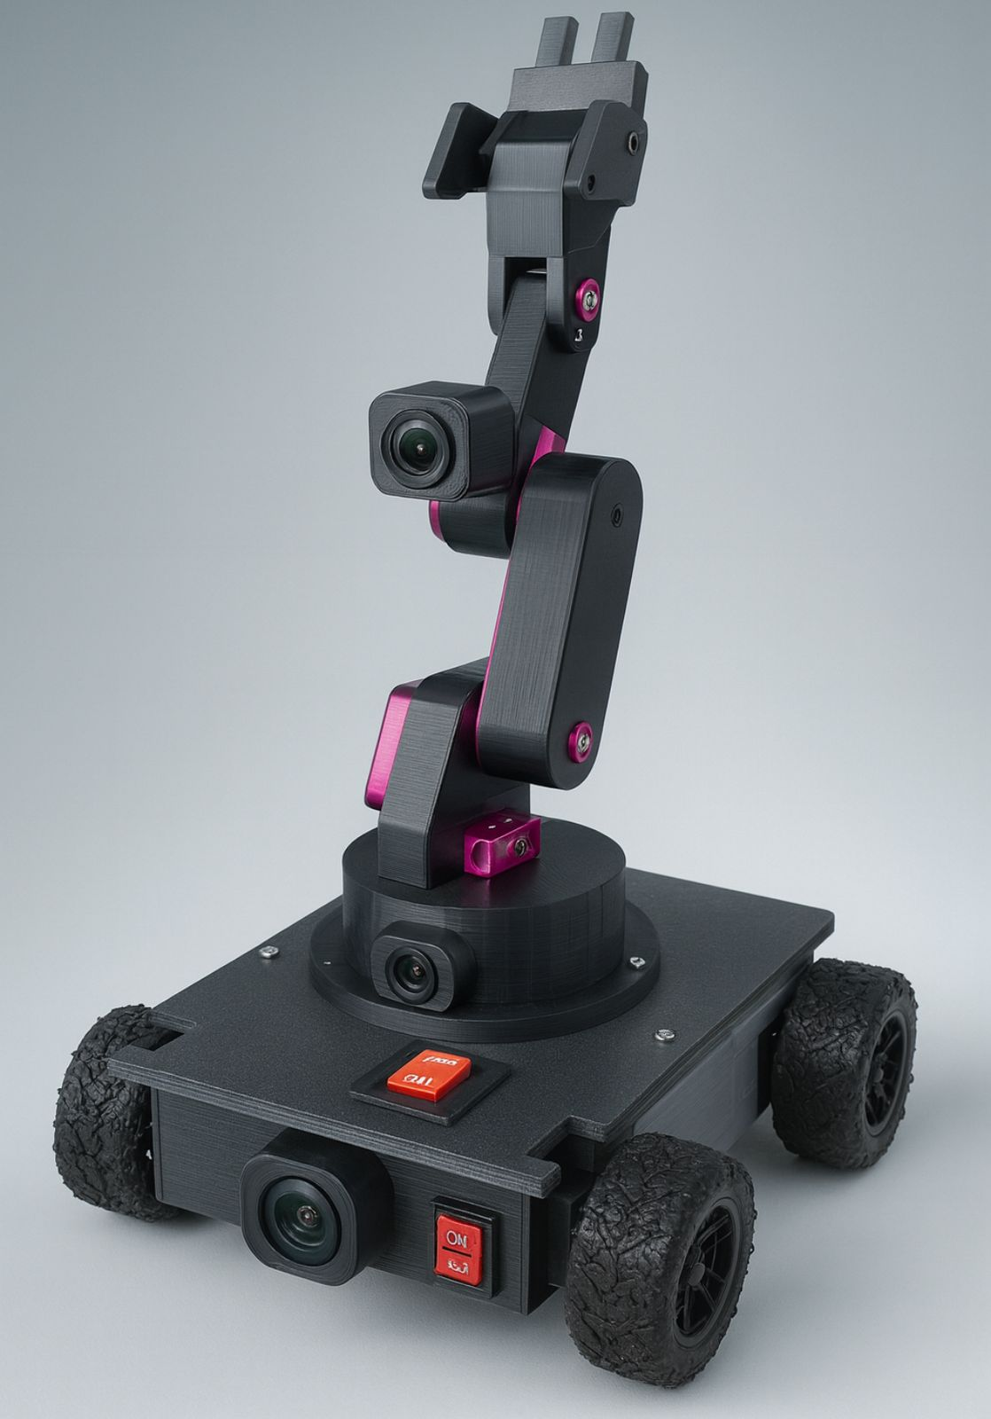
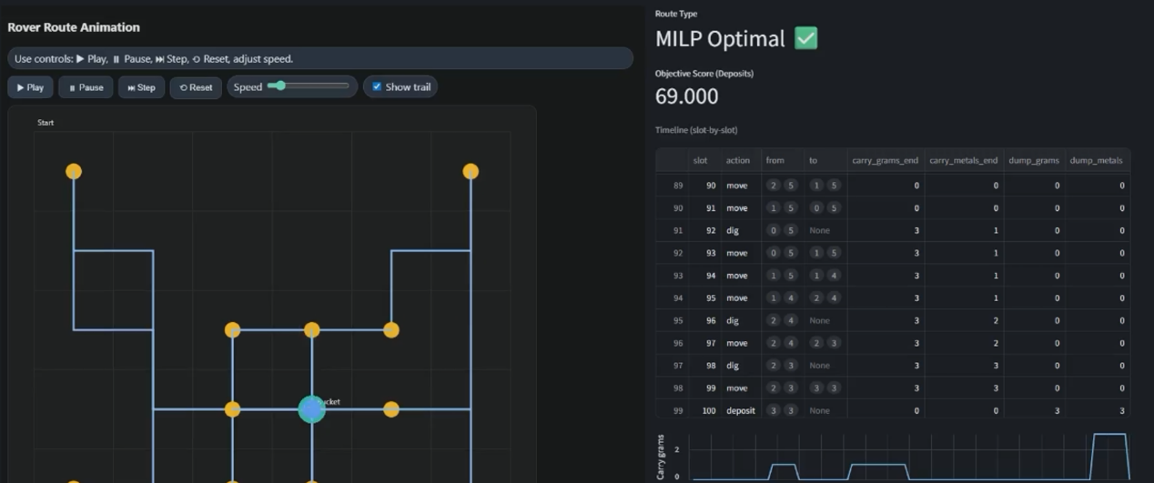
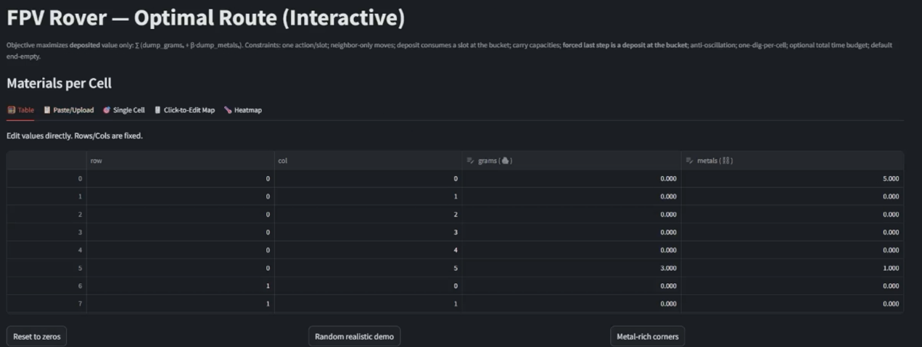




IAM3D Remote Operations Vehicle for the Excavation of Resources (R.O.V.E.R)
TEAM
021
Moath Alqahtani, Omar Modaihij, Mashae Alzabi, Abdulziz Algasham
Coach: Dr. Muhammad Emzir
Situation
Constraints
Specifications
Winning Strategy
This project was developed for the ASME IAM 3D Competition, where teams must design and 3D printed rover from scratch to excavate, transport, and deposit resources under FPV control within strict size, time, and safety constraints.
Size (30.48 × 30.48 × 30.48)
Transport and deposit at least 50 g of resources within the 5-minute
1
Phase I: Exploration first (30s)
4S Battery & Physical Kill switch
Domain
Knowledge
Excavation system must handle resource objects sized between 1 cm³ and 10.16 cm³.
+
=
Springs Max D=1.27 cm, L=5.08cm
3 min setup & 5 min run limit
Detect metals
Scan Strategies
FPV system high-quality continuous video
2
Phase 2: Optimization
Chassis must be 3D printed
Operated via FPV
$$min{\sum_{p∈\left\{C , t_{1} , … , t_{K} , B\right\}}{.}}\sum_{q≠p}{d\left(p , q\right) x_{pq}}$$
6. Vehicle weight not exceed 4.5 kg
Full MIP Model (integrated)
Live Solution Dashboard
Problem Statement
Prototype Design
Testing and Validation
Design and fabricate a mostly 3D-printed FPV-controlled rover that can reliably excavate, transport, and deposit resources within 5 minutes
Dual FPV cameras (front + arm)
Simulated many scenarios through valid Models
Multi-joint robotic arm with high-torque servos enables scooping, gripping
Two Arduino Unos split control
Objectives
For more information and videos, please visit the QR code
Raspberry Pi handles PS4 input
Design a functional 3D-printed FPV rover
TPU terrain-adaptive wheels with strong grip for sand
Conclusion
Apply optimization and safe system operation.
3D-printed chassis engineered for strength, low weight
The project successfully developed a functional, 3D-printed, FPV-controlled rover with a robotic arm to reliably excavate, transport, and deposit resources within the 5-minute competition limit
Excavate, transport, and deposit resources efficiently
Integrated kill switch ensures instant system shutdown

