Slide 1
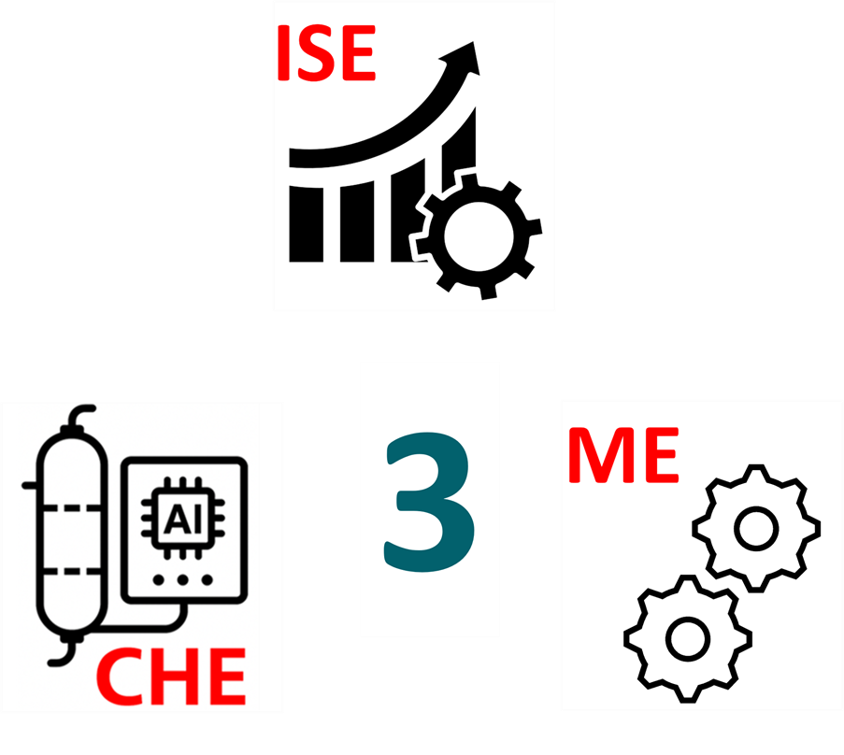
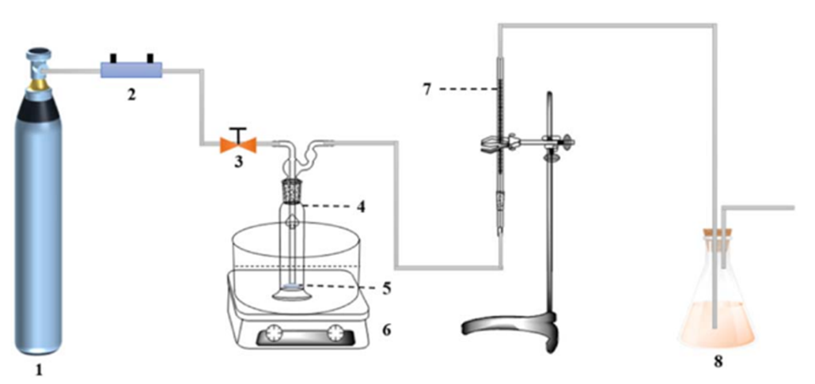
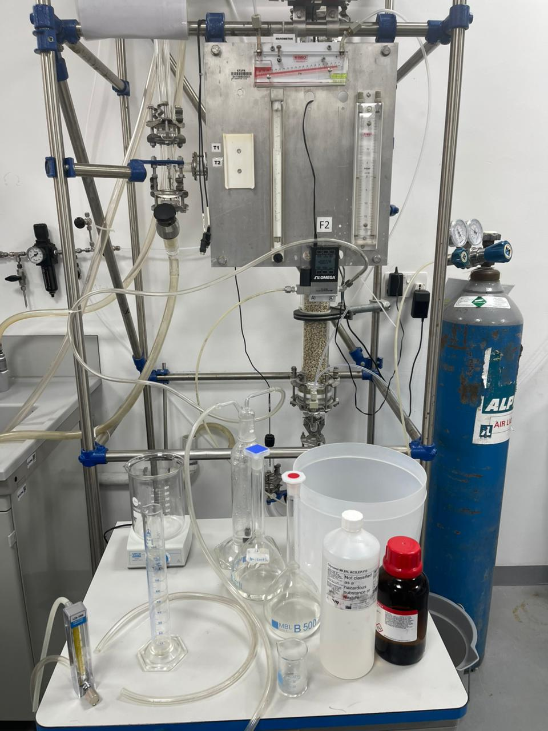
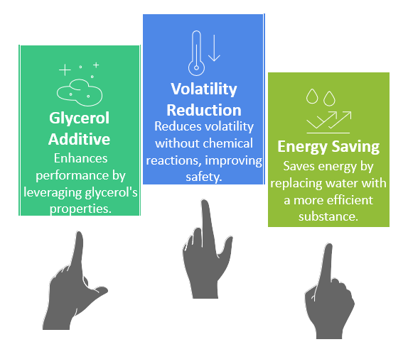
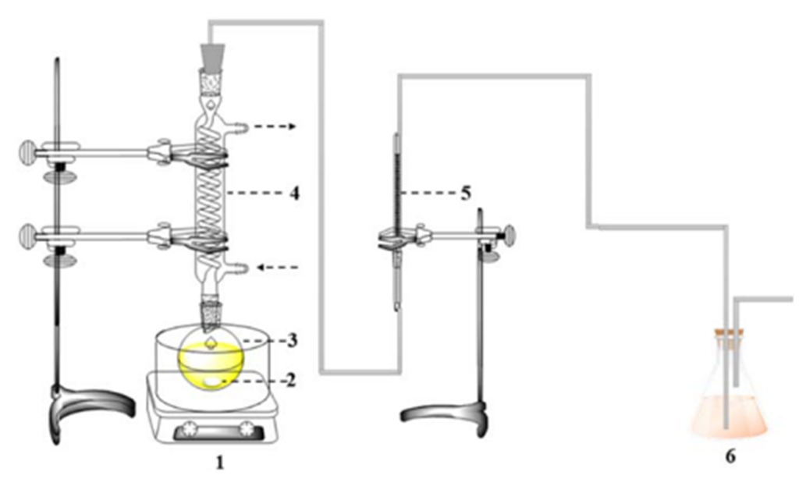
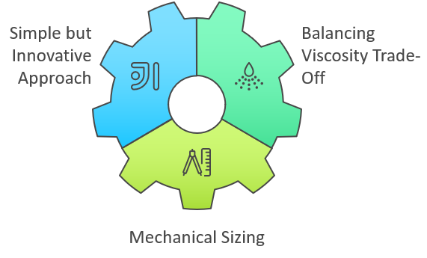
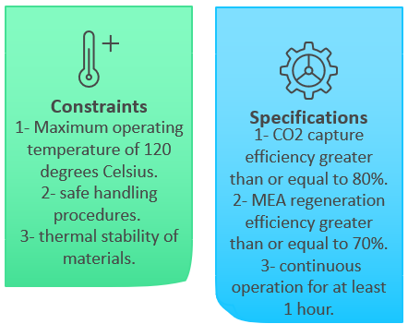
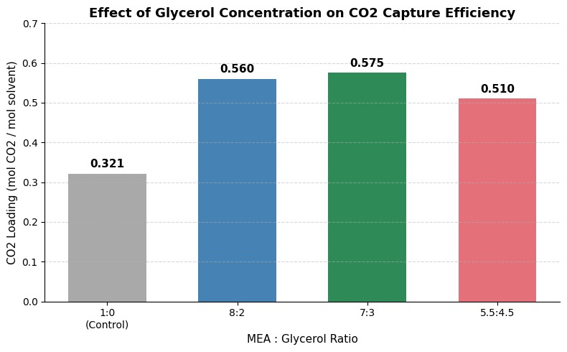
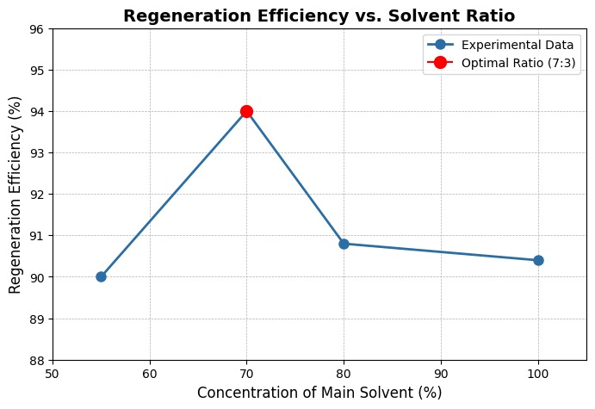
Enhancing CO₂ Capture Using MEA + Glycerol Solvent Blends for Reduced Solvent Loss and Energy Demand
TEAM
016
Waleed Hamadalla, Abdulelah Alharbi, Musallam Alhajji, Albaraa Alzahrani
Coach: Dr. Esam Alhomaidhi
Elevator pitch
Schematics
Prototype
Novelty
Companies like Aramco and Air Products face a problem with CO₂ capture systems that rely on MEA alone: they consume too much energy, require constant maintenance, and suffer from solvent volatility and degradation. our MEA + Glycerol blend is a CO₂ capture system that delivers significantly improved energy efficiency. Unlike standard MEA, our solution offers greater solvent stability, reducing both losses and long-term costs.
Creativity
Constraints & specifications
Experimental Results
Conclusion
From the results of the experiment, we can see that the 7:3 ratio had the best CO2 capture efficiency at 0.575 mol CO2 per mol solvent, as well as the best MEA + glycerol solvent regeneration efficiency at 94%.

