Slide 1
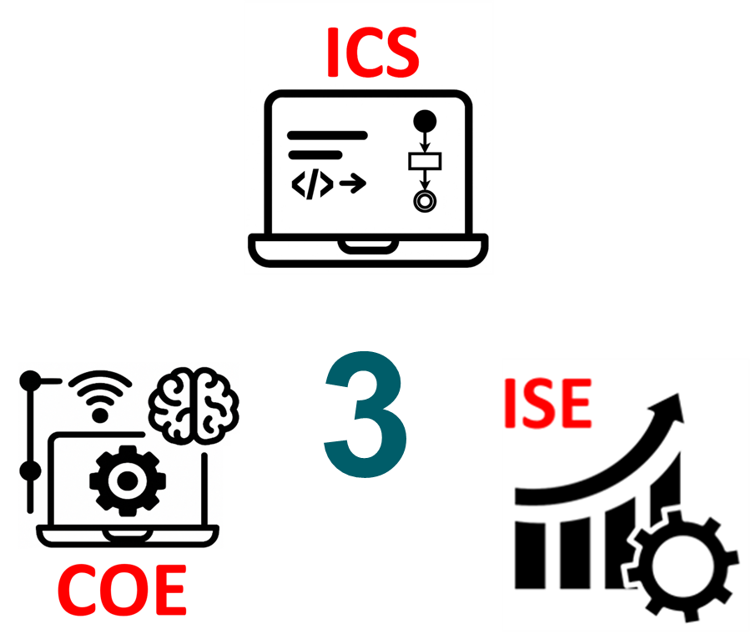
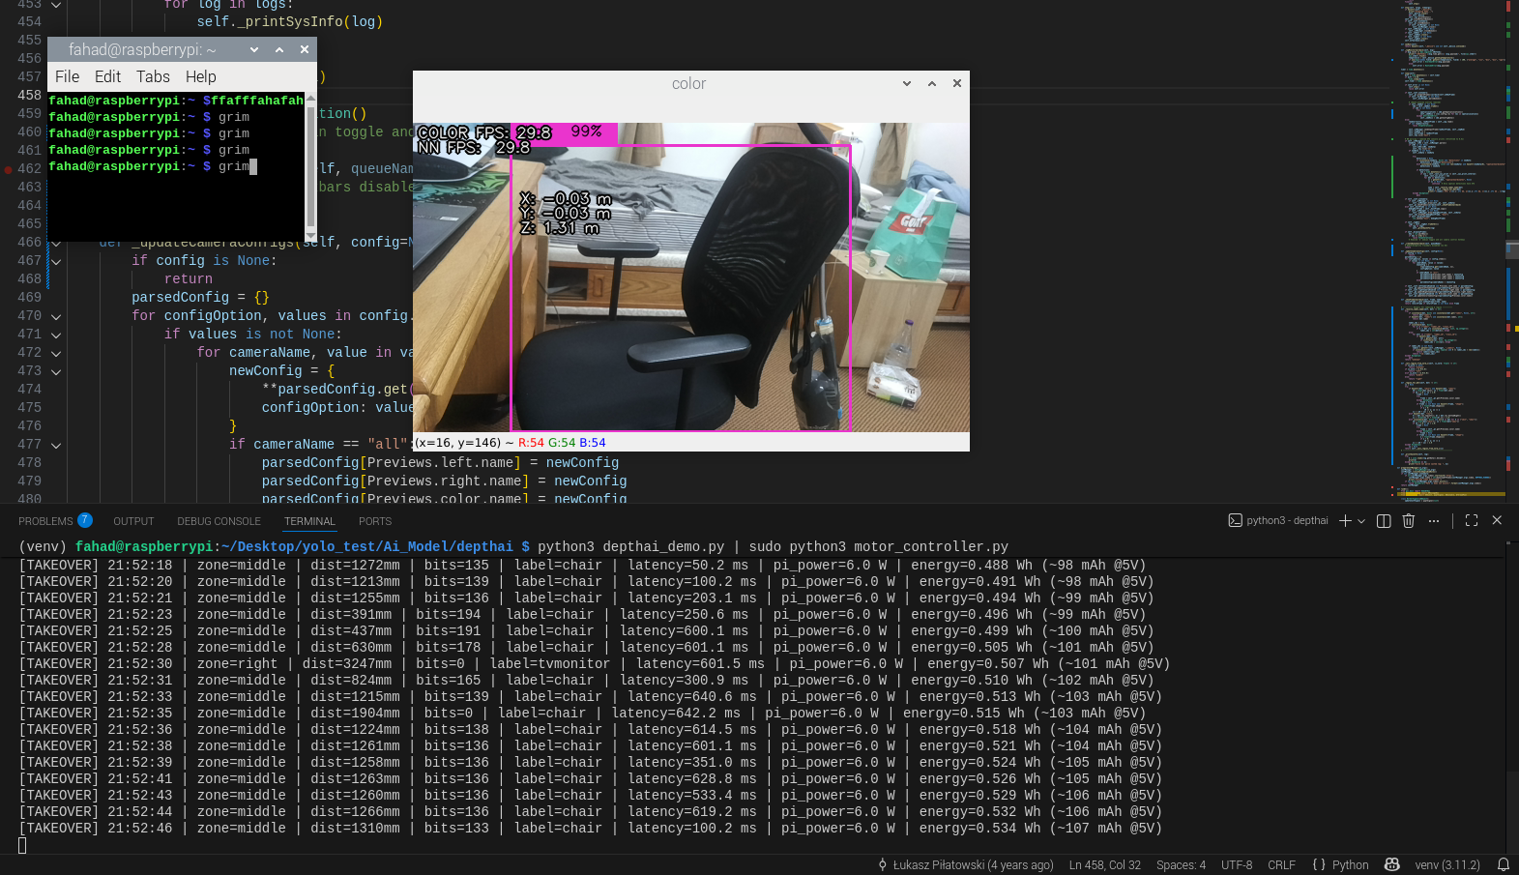
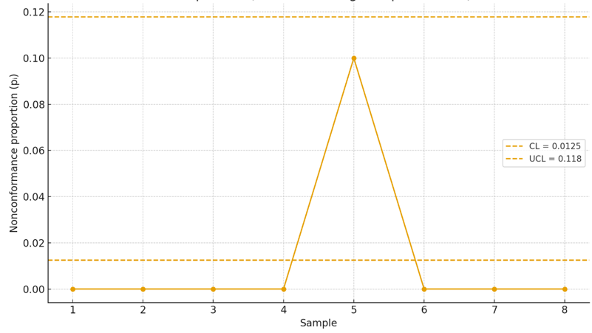
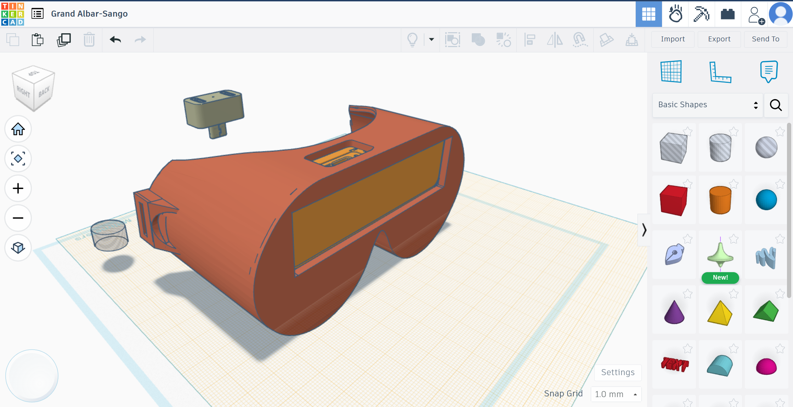
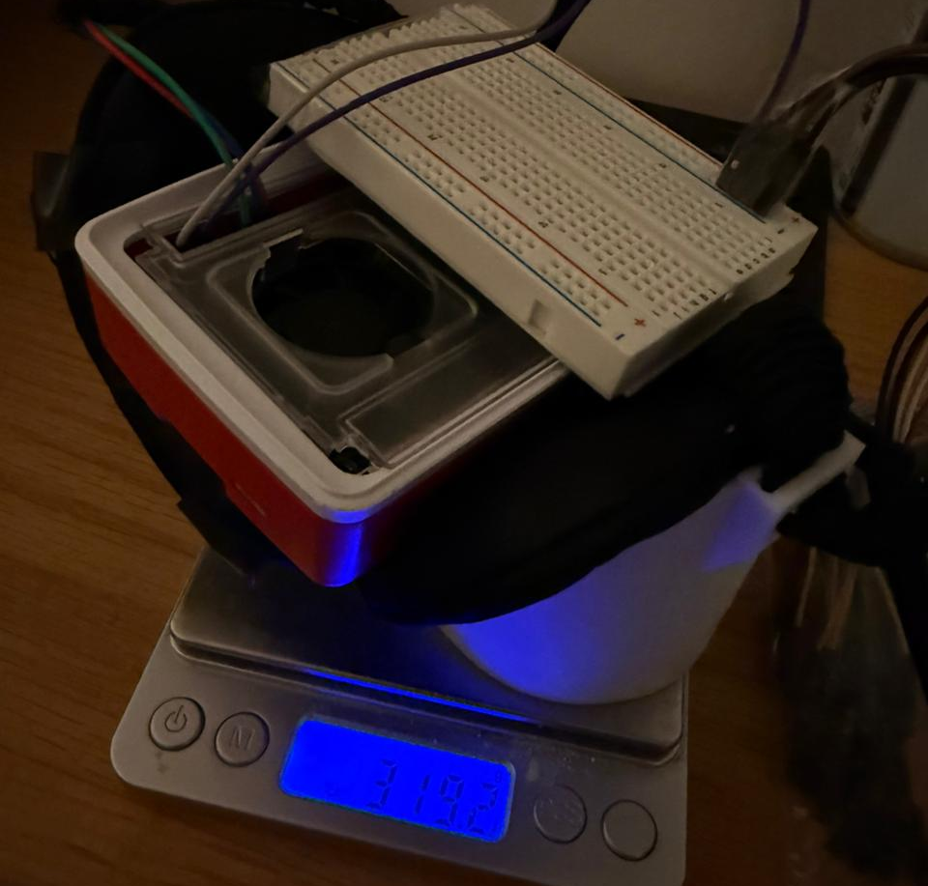
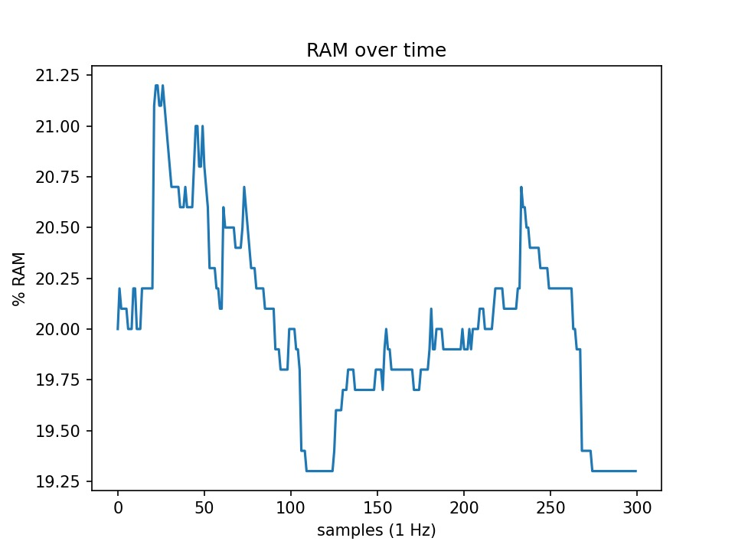
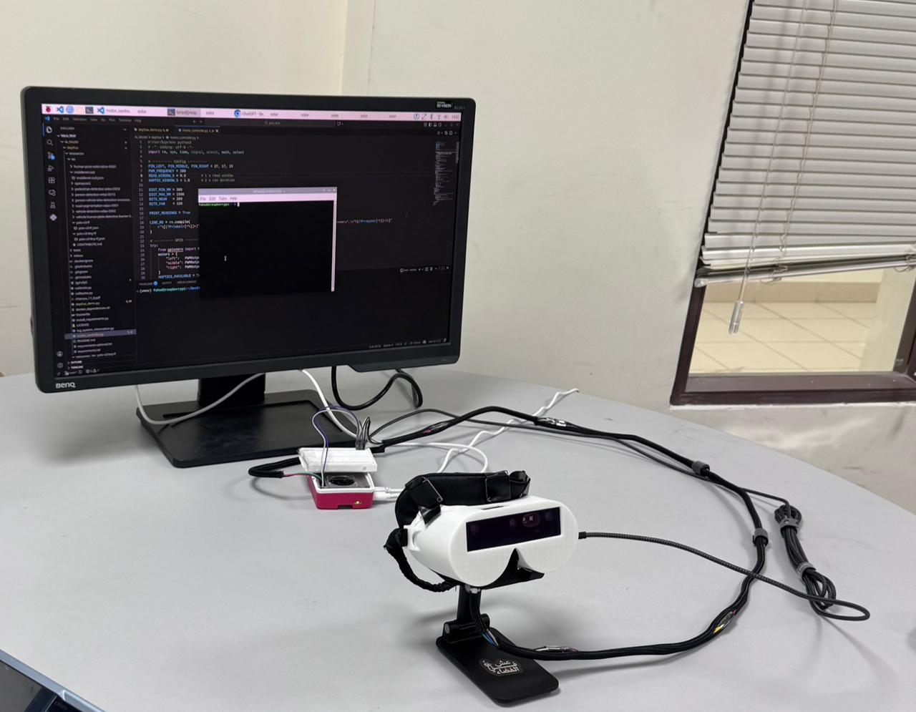
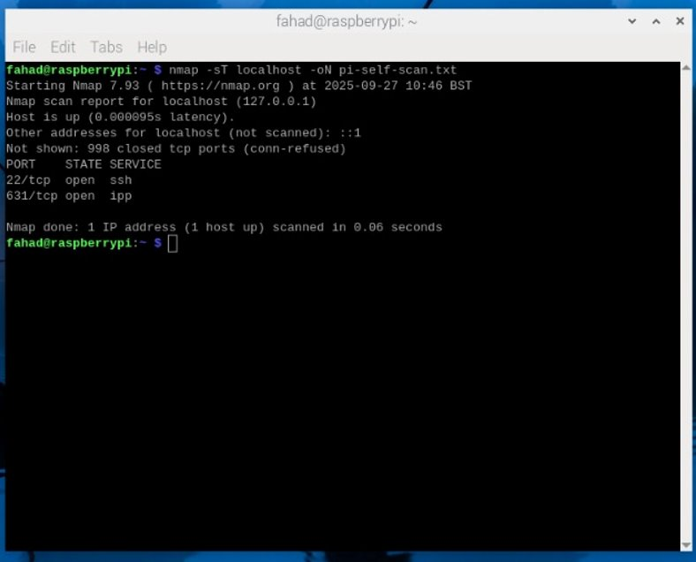
AI-Driven LiDAR Navigation Glasses with Adaptive Haptic Guidance for the Visually Impaired
TEAM
014
Fahad Khamis, Mohammed Almadani, Mohammed Aljamili, Ahmed Alajrafi
Coach: Dr. Firas Alhindawi
Problem Statement
Integrated Specifications
Validation & Verification
Validation & Verification
Visually impaired people rely mainly on canes and audio cues, which provide limited information about where obstacles are and at what distance. Our goal: augment, not replace, existing tools with a hands-free, quiet, haptic “sixth sense” for nearby obstacles.
Battery life: ≥ 1-hour continuous use.
Weight: ≤ 650 g (belt + electronics + power bank).
Latency: end-to-end ≤ 1000ms latency.
Cost: total hardware cost < 5500 SAR.
Power/mAP/Delay/Classification
Non-Conformance Rate
Prototype Design
Constraints
Weight
RAM use: avg ≤ 70% of 8 GB.
Ergonomics: neckband fits ≥ 90% of adult head/neck sizes.
No personal video or location data stored & unnecessary ports closed.
Benefit-to-cost ratio ≤ 1.5.
RAM Usage
Specifications
Conclusion
detect 5 classes (car, person, chair, door, tree) with mAP of ≥ 83% overall.
3-level spatial haptics mapped to left / center / right neck motors.
Local processing and unnecessary ports closed
Modification ability stored in a <5 kB config file.
≤ 2 min time from power-on to ready.
Non-conformance rate <6% & 95% CL, with SPC p-chart (CL±3Ꝺ)
Our project turns 3D vision into simple, directional neck vibrations, giving users an extra “sense” for nearby obstacles without sound, screens, or hands. Our prototype meets its key design targets for latency, battery life, privacy, RAM usage, and comfort, proving that a small, low-cost wearable can deliver meaningful spatial awareness in real time.
Privacy & Local processing

