Slide 1
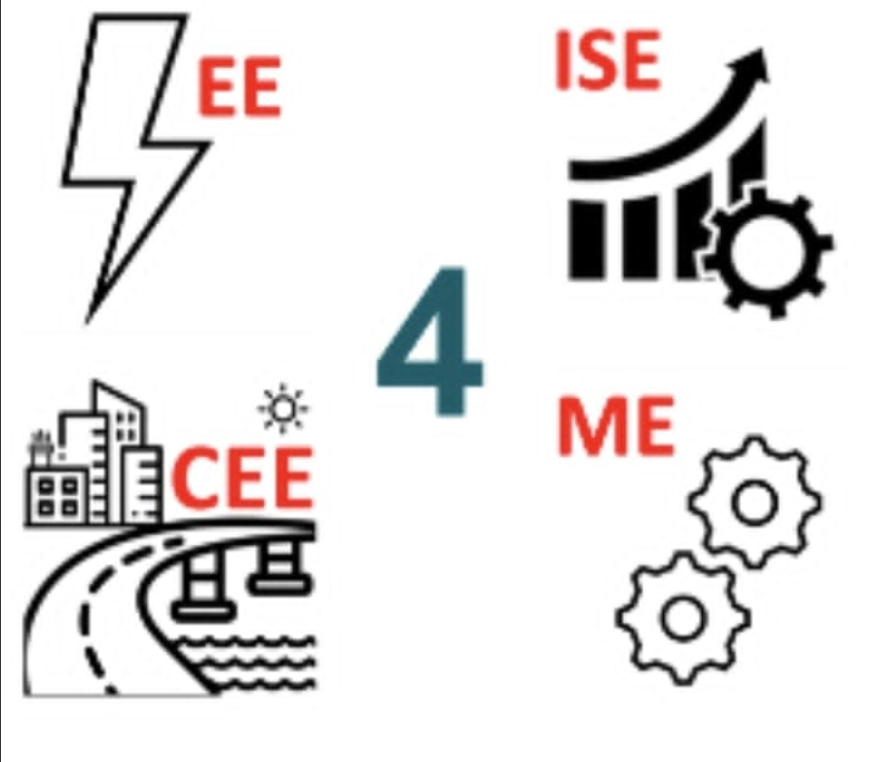
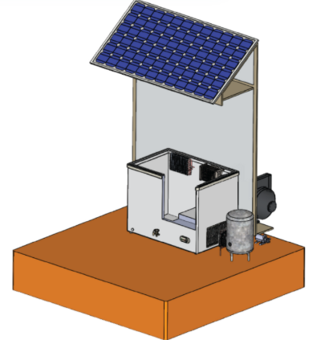
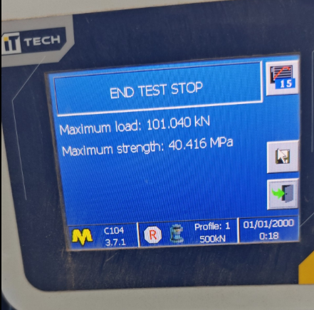
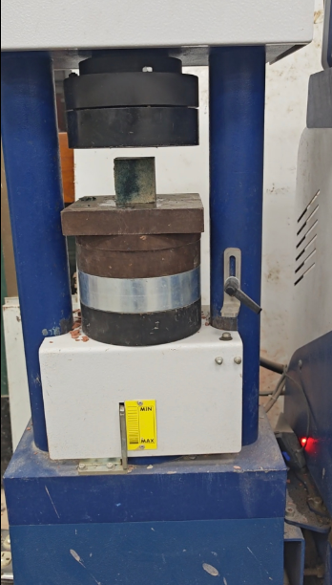
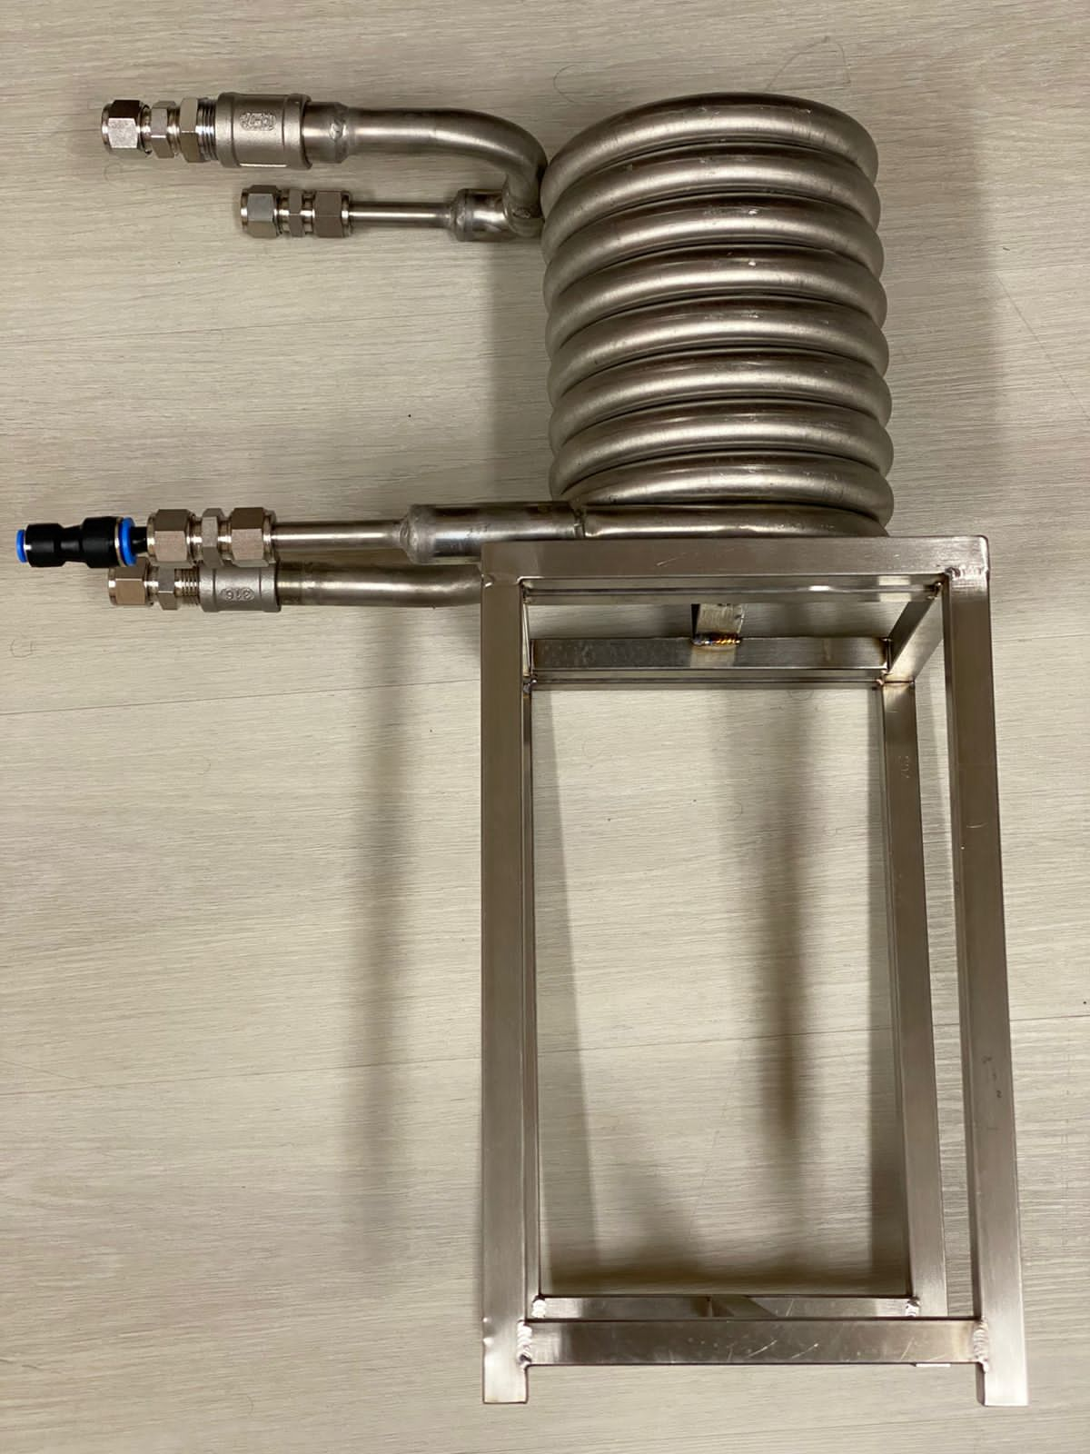
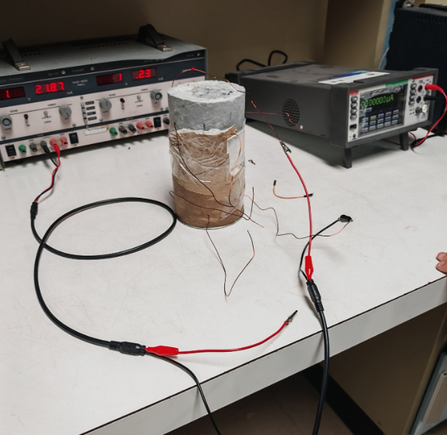
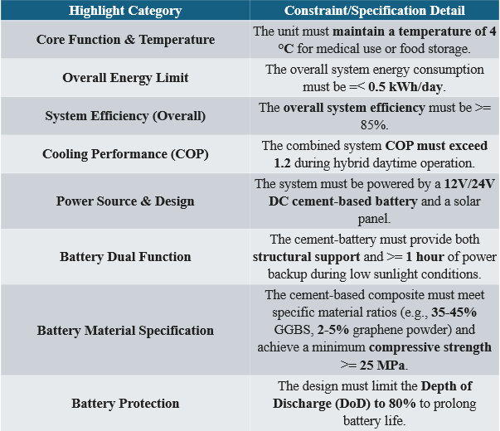
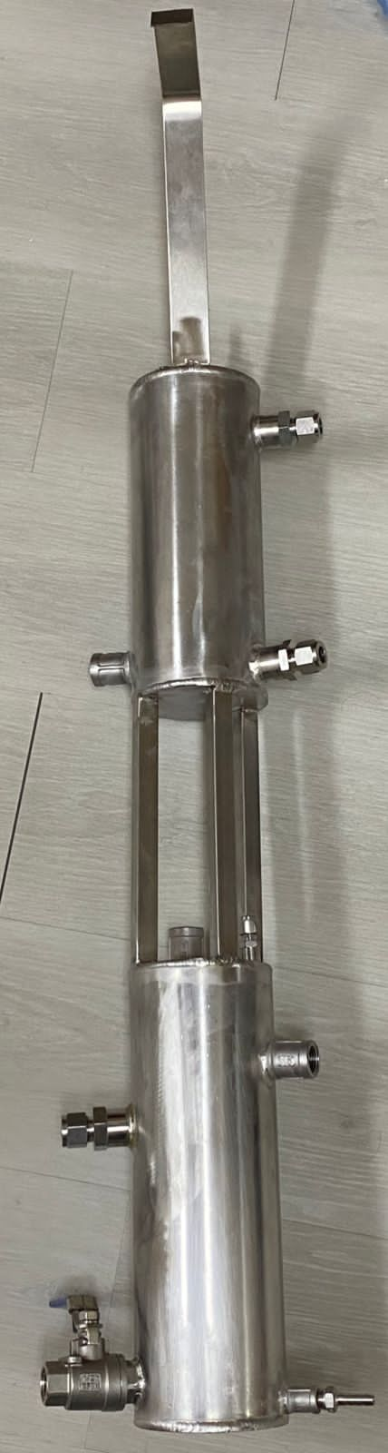
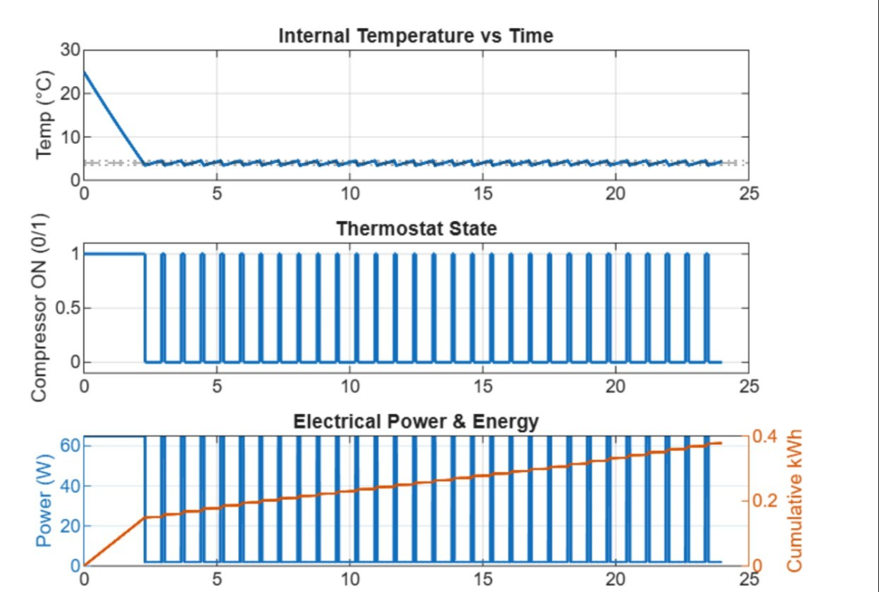
Hybrid Refrigerator Charged with Cement-Based Battery
(HRCCBD)
TEAM
012
INSERT HERE The Multi-Disciplinary Strength logo
Mohammed Alshawaf (ME) , Murtadha Alhashim (CE) , Ahmed Alshawaf (EE), Eyad Alnasser (ISE) Coach: Dr. Bilal Al-Momani (ME)
Introduction
Prototype Design
Testing/Validation
Problem Statement:
stainless Steel Helical Coil Heat Exchanger with Structural Frame
The high energy demand of conventional refrigerators and the lack of sustainable, safe and environmentally friendly energy storage solutions prevent reliable off-grid solar cooling. This project solves both problems by combining a low-power hybrid refrigeration cycle with a cement-based battery for continuous night-time operation.
Cement-Battery Composite exceeded 25 MPa minimum, achieving 40.416 MPa. Structural integrity for the cooling system is confirmed.
Cement battery under electrical test in lab for charge-discharge evaluation.
Double-Cylinder Stainless Steel Heat Exchanger/Thermal Storage Prototype
Refrigerator System Performance Graphs (Temperature, Thermostat State, Power & Cumulative Energy vs. Time)
Conclusion
The hybrid refrigerator project successfully delivered a **sustainable cooling solution. It achieved the target temperature range with **high energy efficiency. The novel **cement-battery composite's structural strength** was successfully validated.

