Slide 1

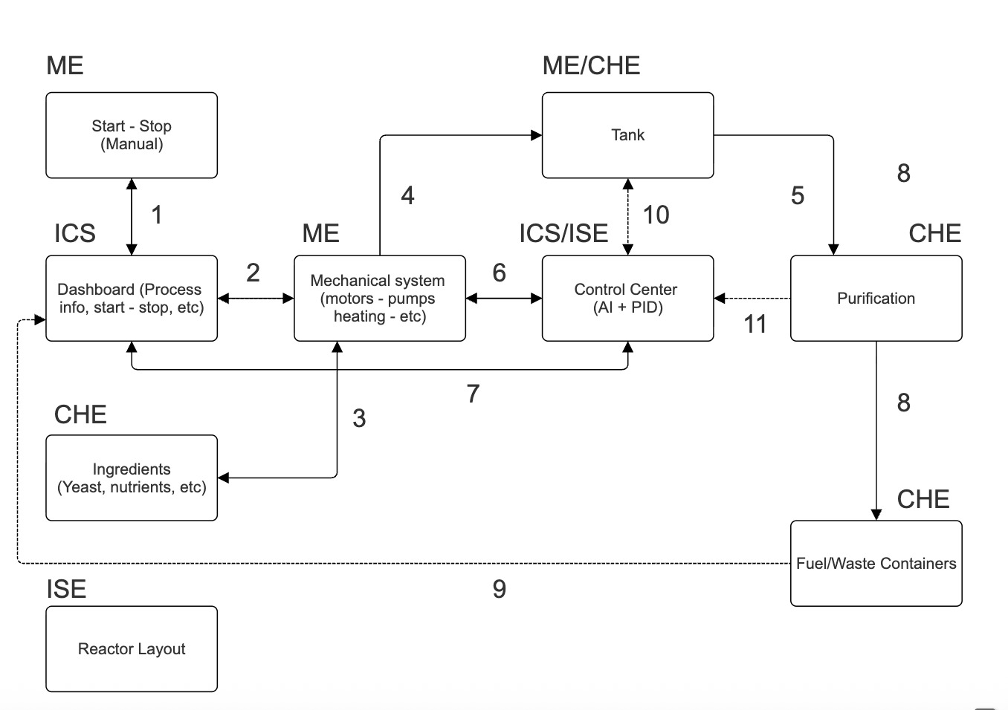

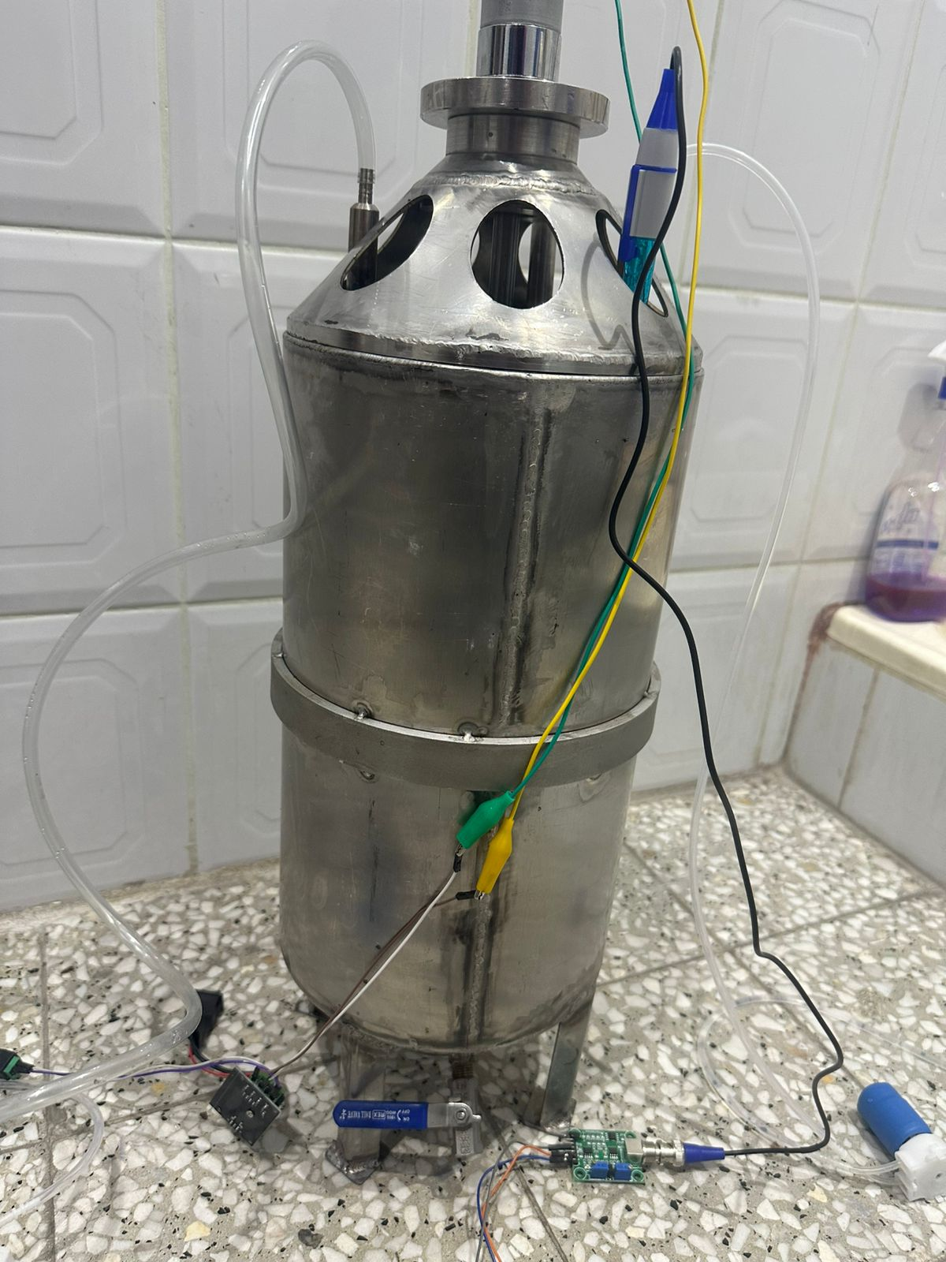
AI-Powered Smart Bioreactor for Optimized Biofuel Production
TEAM
010
Abdulhameed Alsaif, Ali Almatrood, Haidar Alnasser, Mohammed Albasarah
Coach: Fadi Al-Badour
Background
Key Constraints
Prototype Development
Validation & Verification
Conventional bioreactors often suffer from inefficiency and high operational costs due to static operating conditions. Small variations in pH, temperature, and mixing can drastically reduce biofuel yield.
Budget: Total cost must be < 6,000 SAR.
Safety: System must be vented and non-pressurized).
Modularity: the system must be modular.
Software: the system must use an open-source software.
Aspen Plus simulation verified the process thermodynamics, confirming an upgrade from ~6% wt ethanol in broth to 85% v/v in the final product stream
Problem Statement
Specifications
Control: Raspberry Pi 5 + ADS1115 architecture handling real-time data acquisition from industrial sensors.
Closed‑Loop Actuation: Control logic drives the DC motor and dosing pumps via real‑time sensor feedback, correcting deviations automatically
Optimality: the system has an optimal layout+ Silver meal heuristic for production management
AI: reinforcement learning model integrated with the dashboard to get an insights of the process.
Traditional lab-scale bioreactors rely on fixed recipes and manual adjustments. This leads to inconsistent yields and wasted energy because they cannot adapt to real-time fluctuations in pH or temperature.
Objective: To design, build, and validate a 10 L AI-driven bioreactor that uses closed-loop control to stabilize fermentation conditions.
Solution: An integrated system that automates temperature, pH, and mixing to increase ethanol yield and minimize power consumption
Temperature Control: Maintain the setpoint within ±1 °C to ensure stable fermentation conditions.
pH Regulation: Keep pH within ±0.5 units of the target value for optimal microbial activity.
Agitation System: Provide variable speed mixing in the range of 100–500 RPM, allowing flexibility for different process needs.
Energy Efficiency: Ensure the average power draw remains below 500 W, supporting sustainable and cost‑effective operation.
Optimality: achieve >90% of the theoretical yield under optimal conditions
Conclusion
Functionality: Built a working 10 L smart bioreactor integrating mechanical, electrical, and chemical subsystems.
Efficiency: Operates at ~50 Wh/L, well below the energy limit, enabling renewable integration.
Impact: Modular, open‑source design supports lab‑scale biofuel research and sustainability goals.

