Slide 1
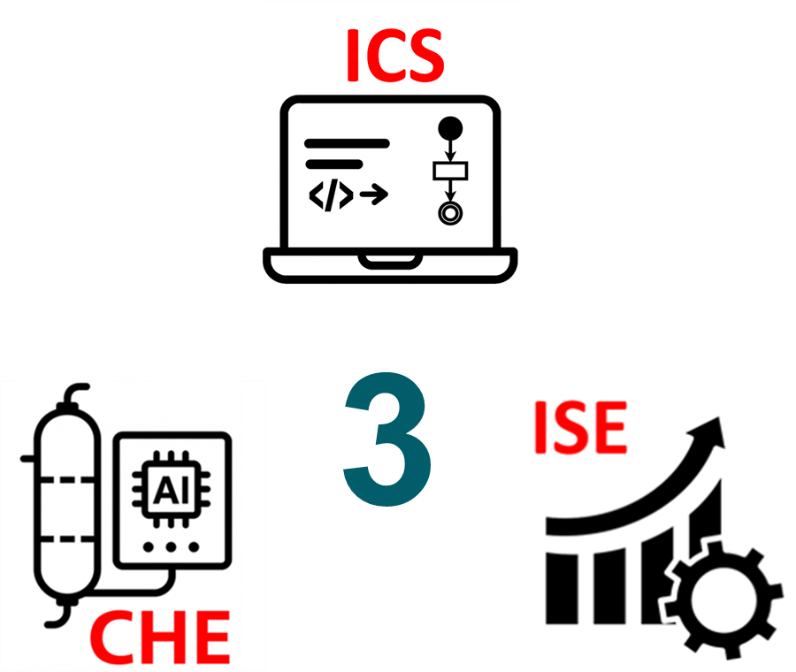
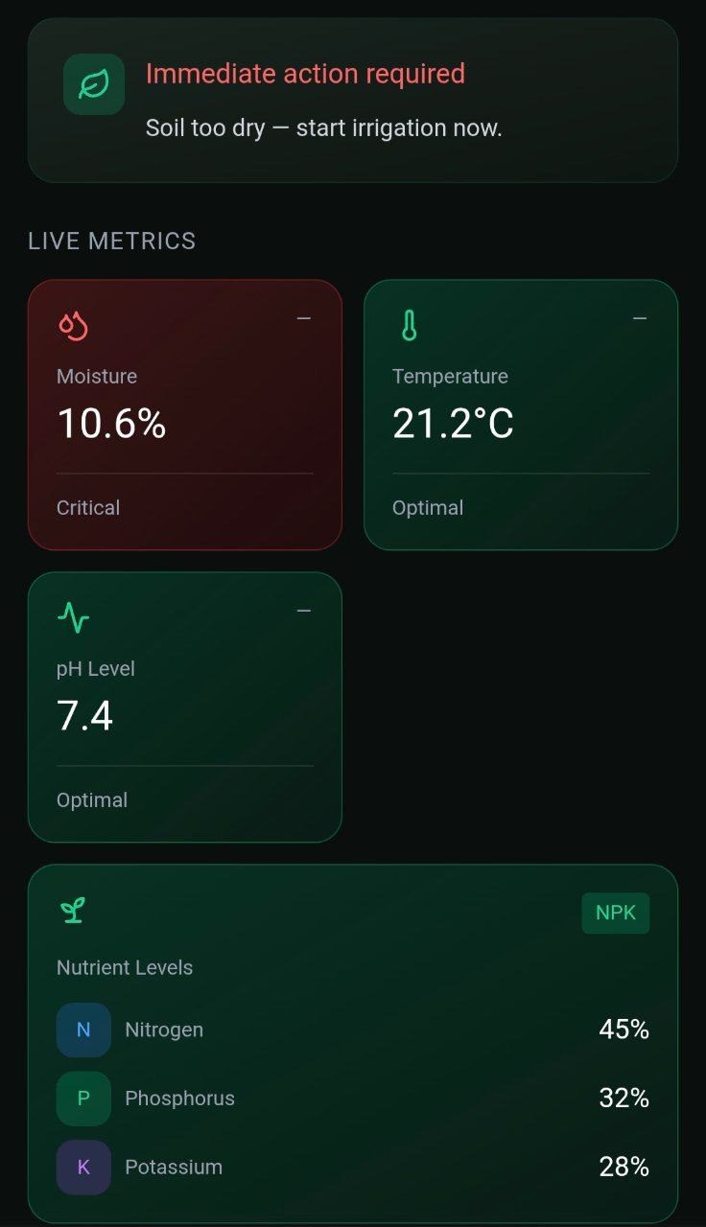
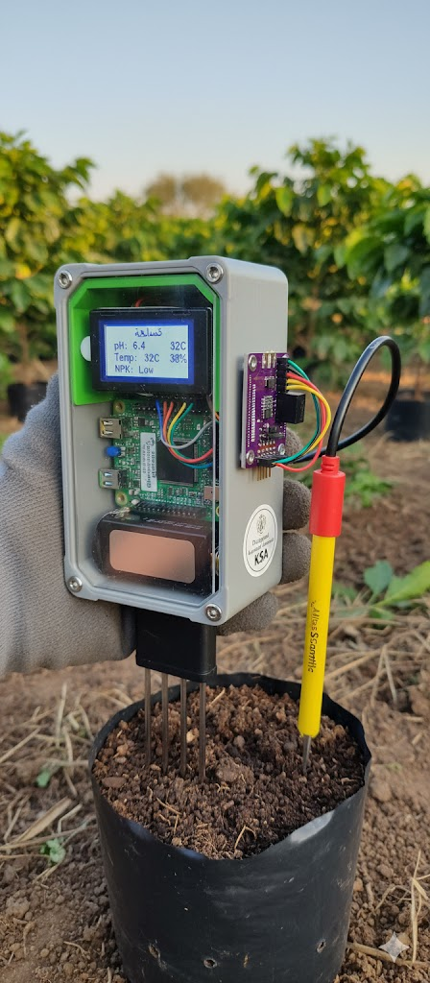
Smart Soil Analysis Device for Coffee Cultivation in Saudi Arabia
TEAM
008
Eyad Shaikh Omar(202031120), Faisal Al-Sulimani, Baraa Saleh Al-Sahoud, Rashed Alghamdi
Coach: Dr. Asad Hanif
Problem statment
Testing / Validation
Prototype Design
Saudi Arabia faces a lack of localized soil data and technological support for coffee farmers, creating a significant barrier to sustainable domestic production. To address this, our project develops a "Smart Soil Analysis Device" that provides an accessible, real-time, and data-driven solution for monitoring and improving soil conditions. By bridging the gap in scientific data, this device supports the growth of the local coffee industry, reduces reliance on imports, and contributes to the country's agricultural sustainability.
Soil sensor accuracy within ±5% across dry/medium/wet tests.
Dual-serial data stream validated (RS-485 + pH).
Firestore updates received in 1.2 s; dashboard auto-updated.
Offline buffering with 0% data loss
Use font size 46 or above
Specifications
pH Range: 4 – 9 ( 0.4)
Moisture Range: 0%- 100%
Temperature Range: 10 C - 70C
Measurement Accuracy: Within 5% error
Success Rate:  85% valid tests
Database: Scalable with historical optimization records
Conclusions
This project successfully integrated chemical sensing, embedded processing, and quality optimization into a unified, portable prototype for real-time measurement of critical soil parameters. By establishing a robust system architecture and defining comprehensive validation frameworks, the design lays a strong foundation for a statistically reliable tool tailored to sustainable Saudi coffee cultivation
Constraints
Integrated specification
Max Operating Temp: Up to 50C
Power Source: Rechargeable Battery (Off-grid capable)
Key Parameters: pH, Moisture, NPK, Temp
Standards Compliance: Local Agricultural Standards
Max Humidity: Up to 85%
Guidance Response Time:  2 minutes
Guidance Reliability:  70%
Local Storage:  100 test records
Weight: 0.5 – 1.5 kg (compact)
User Interface: LCD Screen or Mobile App

