Slide 1
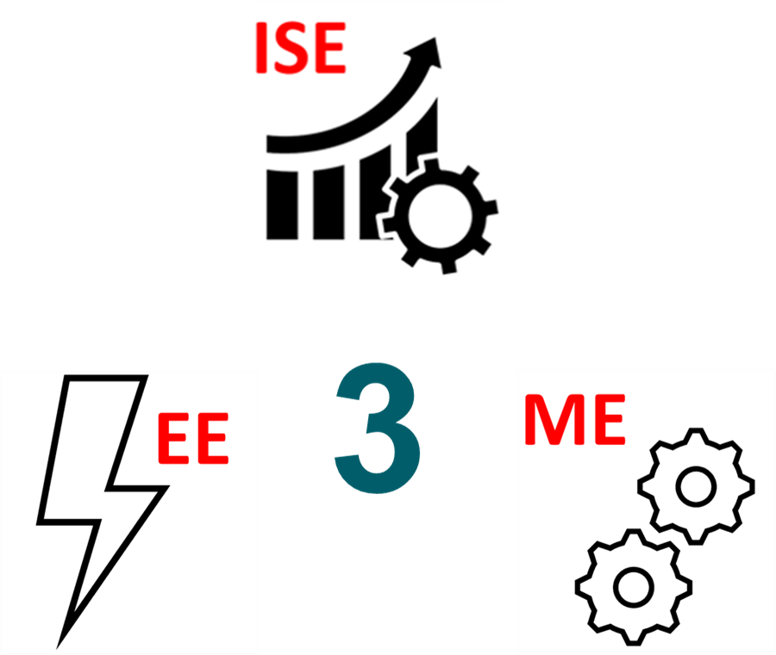
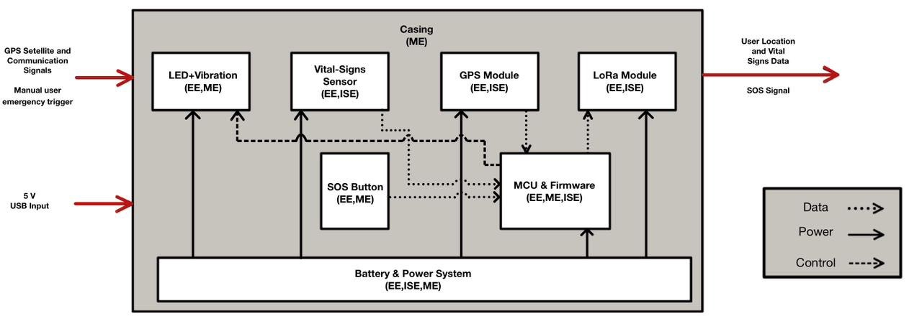




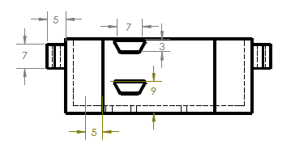
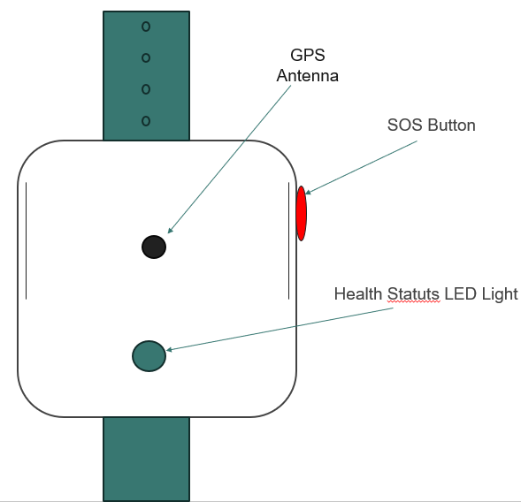

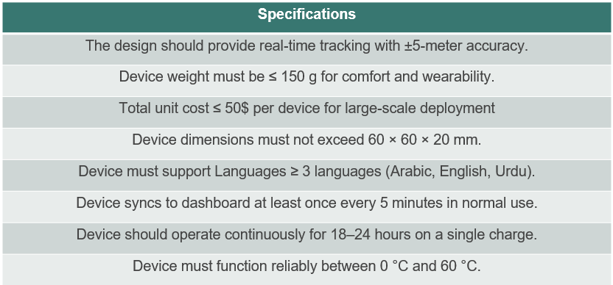
Smart Wearable Navigation Device for Hajj Pilgrims
TEAM
006
Mohammad Alsadah (EE) , Mustafa Alomran (EE), Hasan Al Yousef (ME), Mahdi Al Rumaih (ISE)
Coach: Dr. Wail Mousa
Background
Prototype
Constraints
Tests & Validations
Millions of pilgrims attend Hajj in extreme heat and crowded conditions, creating risks of getting lost, heat exhaustion, and delayed emergency response. Existing systems do not provide individual-level monitoring or real-time guidance.
Cost ≤ $50 per device for large-scale deployment
Weight ≤ 150 g for comfortable all-day wear
Size ≤ 60 × 60 × 20 mm to maintain portability
Test Item | Method | Result | Specification / Status
Heart Rate & SpO₂ (MAX30102) | Sensor test on wrist in indoor conditions | Stable readings, few motion outliers | Functionally acceptable
Temperature (NTC Thermistor) | Compare readings to reference thermometer | Smooth, accurate temperature values | Meets expected behavior
WiFi Dashboard (ESP32 AP) | Connect via phone/laptop browser | Live GPS, HR, SpO₂, temp, SOS status visible | Real-time monitoring achieved
Integrated System Test | Run full system with all modules active | All subsystems operate together | Core functionality validated
Battery Life | Continuous run under typical duty cycle | ≥ 12 hours operation | Meets ≥12 h requirement
GPS Accuracy (BN-220) | Outdoor test vs. known reference point | ≈ 3–4 m error | Meets ±5 m requirement
Problem Statement
Rechargeable Li-ion battery required for safety and reuse
Pilgrims lack a personal system that tracks their location, monitors vital signs, and sends instant SOS alerts. A wearable solution is needed to enhance safety, navigation, and emergency response during Hajj.
Comfortable, adjustable strap suitable for diverse wrist sizes
Specifications
Conclusion
The smart wearable device meets its core goals by providing accurate GPS tracking, vital-sign monitoring, and reliable SOS alerts in a compact, comfortable design. Testing confirms strong performance across all major specifications, demonstrating a practical solution to enhance pilgrim safety during Hajj

