Slide 1
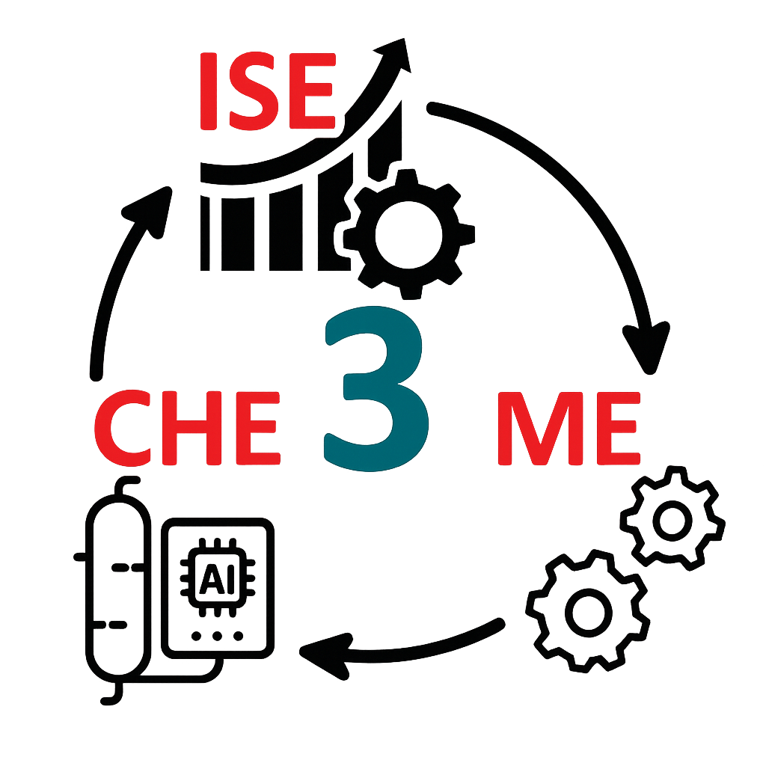

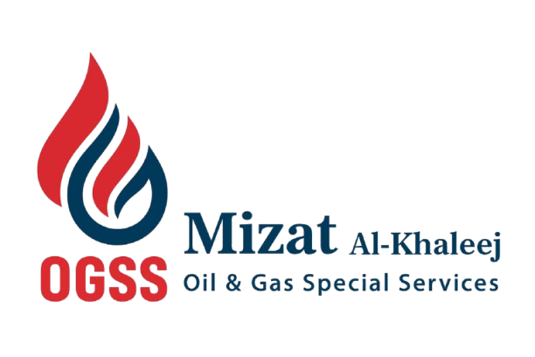
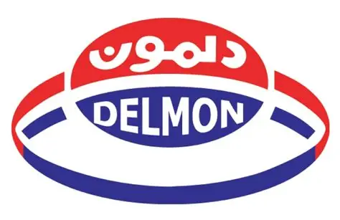
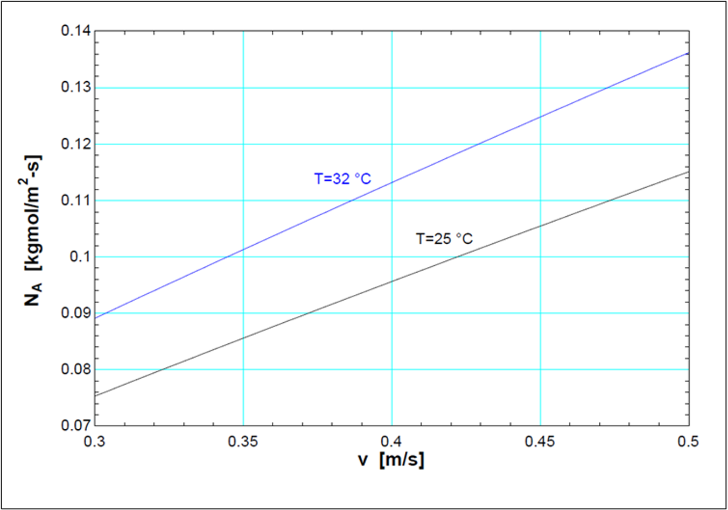
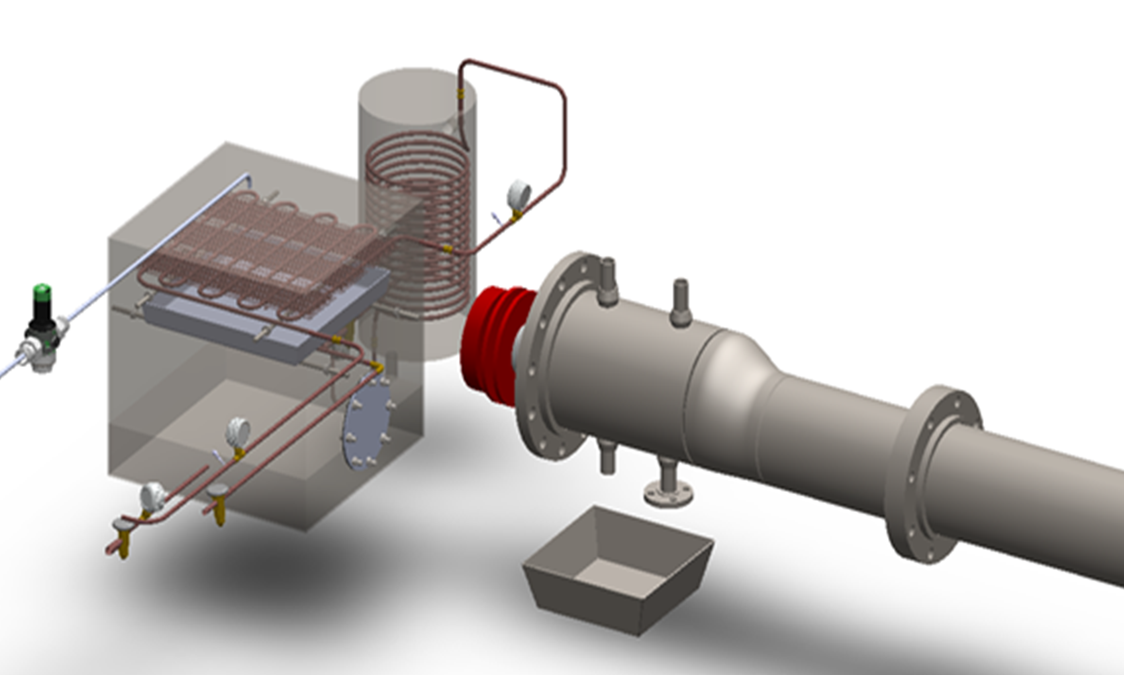
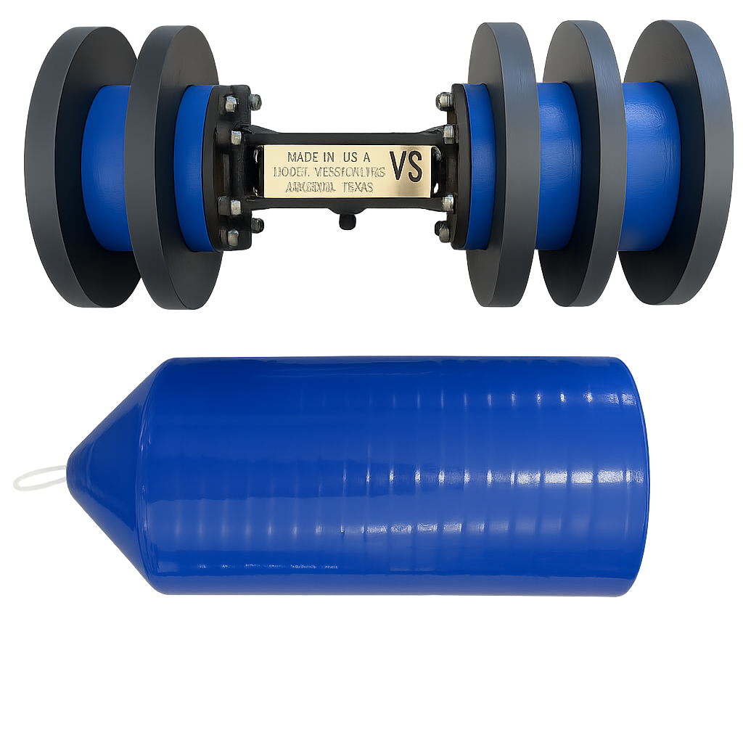
TEAM
005
Advancing OnG Pipeline Cleaning Utilizing Environmentally Safer Products with Circular Waste Management
Faysal Alqahtani (ME), Saad Alshahrani (CHE), Ahmed Moqbel (CHE), Majed Alhudaib (ISE)
Coach: Dr. Asad Hanif
Objective
Target Specification
Acknowledgments
Goals
To develop a cost-effective, recyclable, and environmentally responsible pipe-cleaning solution that enhances cleaning efficiency and supports long-term sustainability.
Minimum Train speed of 0.3 m/s
Optimized values of the cleaning fluid mixture given by the model.
Maximum 5 g/L of solids remainder.
Eco-Friendly
Sustainable
Circular
Compliance
Novelty & Creativity
Limitations
Closed loop chemical treatment
Cost-efficient operation.
Improved pigging design.
Cleaner operation.
Limited Fouling Variability
Laboratory-Scale Operation
Patent Still Pending
Cleaning efficiency
Prototype
Conclusion
The APM system has been fully prototyped and validated, demonstrating efficient cleaning, effective surfactant recovery, and stable closed-loop operation. Results align with predictive models and confirm that the technology is ready to progress into industrial-scale prototyping and broader field evaluation.

